Slide 1
Graduate Student Advising
CISE Department
New Graduate Student Orientation
15 August 2025

Slide 2
Graduate Ph.D. Programs through CISE
Doctor of Philosophy
  College of Engineering
Computer Engineering- CEN
Computer Science- CSE
Human-Centered Computing-HCC

Slide 3
Ph.D. Students-
Please visit our web site at: www.cise.ufl.edu—I am happy to discuss this with you

Slide 4
CAREER FAIR
Be sure to attend the CISE Career Fair.
This is a wonderful opportunity to meet with the many companies that hire our CISE graduate students.
Information will be posted on our Welcome Page found at the following URL- Graduate Student Welcome - Computer & Information Science & Engineering (ufl.edu)
There are many opportunities to volunteer for this important event—emails will be sent to all students-for more information, contact Ms. Sapp at klsapp@ufl.edu.

Slide 5
Individual Development Plan (IDP)
REQUIRED FOR ALL PH.D. STUDENTS IN ALL MAJORS
START HERE: IDP Computer & Information Science Eng (instructure.com)
I am happy to meet with you individually to discuss the IDP.
Please email me at alcook@ufl.edu to schedule an appointment

Slide 6
Ph.D. Registration
STRONG RECOMMENDATIONS
First Term—Discuss your proposed schedule with your advisor
  One core course - ⬄ ⬄ ⬄ ⬄
  Research and if your advisor recommends this 1 CISE elective course
      Core courses typically have a heavier workload than elective courses.
      Students tend to have greater success their first semester if they take only one core course.

Slide 7
Transfer of Credit
Ph.D. students with a master’s can transfer up to 30 credits from M.S., plus an additional 15 credits from post-M.S. work.
Ph.D. students without a master’s can transfer in 15 hours of graduate coursework.
Transfer credit does not satisfy course requirements Ph.D. programs. It only adds to hours earned.
Transfer should be done during the first semester.
  Please be sure to email me directly if you believe you may be eligible for transfer credit.

Slide 8
Core Course Equivalency - 1
If you believe that you have taken a course (or courses), including undergraduate course(s), that is equivalent to a core course in our department, you will need to take the following steps:
  Obtain a copy of your finalized transcript from your prior institution.
  Prepare a copy of the course syllabus and catalog description of the equivalent course(s) as well as any supporting material such as exams, projects, and homework.

Slide 9
Core Course Equivalency - 2
  Provide these items, along with the equivalency form, (I am happy to email the form to you) to the instructor who teaches the core course for determining whether the course can be waived. (this can all be done via email—no need for face-to-face meetings.
Remember: This is a different process than transferring prior credits, a process which should be handled, with the help of your grad advisor early in your first semester.

Slide 10
Elective coursework outside the CISE Department
Ph.D. students Consult your Committee Chair/Advisor for program for electives.
  MUST obtain Advisor permission before taking the course.
  For CPT/Internship information- contact Ms. Kristina Sapp at klsapp@ufl.edu

Slide 11
Supervisory Committees - 1
Ph.D.:
  4 members, three from CISE and one external
  Please go to the following URL for specific information about this Milestone--Ph.D. Program - Computer & Information Science & Engineering (ufl.edu)
Please note: Some faculty in other departments hold appointments in CISE – these faculty members cannot be external committee members.

Slide 12
Supervisory Committees - 2
Committees must be formed no later than the end of the second semester
Committees cannot be changed in the final term, but can be adjusted at any time until the final term.
I am happy to email the Supervisory Form to you—this can all be done via email including signatures

Slide 13
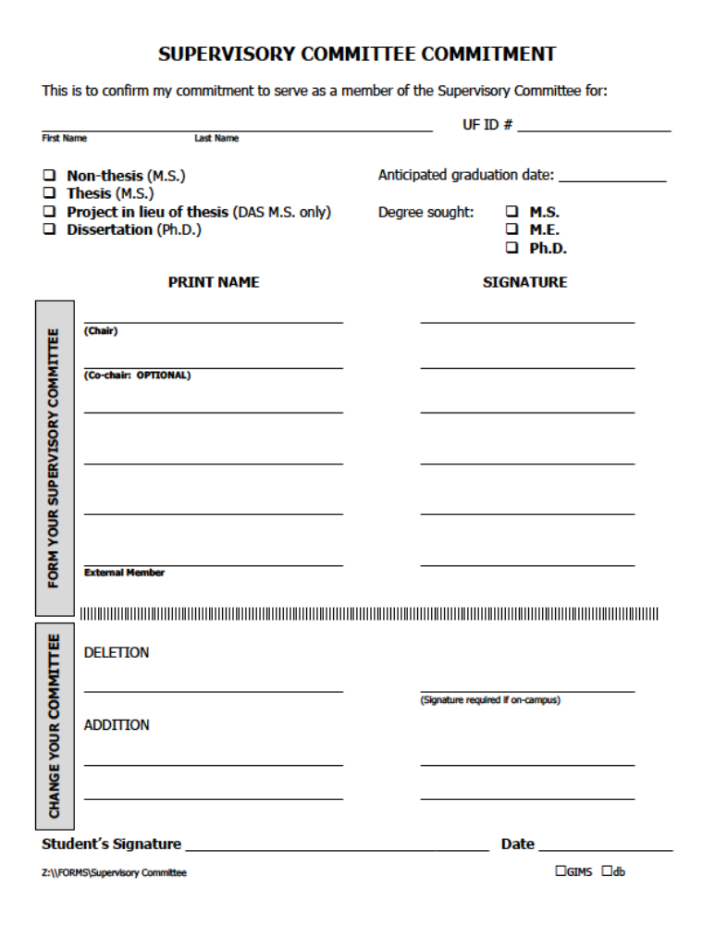
Supervisory committee commitment form

Slide 14
Qualifying Examination
MUST BE COMPLETED BY THE SIXTH (6) SEMESTER
Refer to the following URL for details: https://www.cise.ufl.edu/academics/grad/qualifying-exam-req
Do not wait until your sixth semester to begin

Slide 15
ADMISSION TO CANDIDACY (PROPOSAL)
Inform the committee and set up the oral exam date.
Inform Adrienne L. Cook, of the planned date of the exam
2 Semester Rule to graduation

Slide 16
Dissertation: The Process
Complete the required research
Apply for graduation at the beginning of last term and complete exit process
  Attend graduation meeting at beginning of semester you plan to graduate.
Write dissertation
Schedule your defense
Defend dissertation

Slide 17
About the Ph.D. Dissertation
Most finish in 5-7 years
http://www.cise.ufl.edu/academics/grad/phd/index.shtml#csreq

Slide 18
Ph.D. Degree
Complete required coursework
Apply for graduation at the beginning of last term and complete the exit process (watch for email notification)
For any questions, contact Adrienne L. Cook

Slide 19
Grade Issues
You must have a 3.0 overall grade point average and a 3.0 major GPA to graduate
  Students with less than a 3.0 are not considered in good standing
  Students with GPAs below a 3.0 will be reviewed by the Graduate Affairs Committee for further action (including possible dismissal) at the end of each semester.

Slide 20
Grade Issues – 2
ANY grade < C (e.g. C-, D+, etc.) will NOT count toward graduation
A comment on repeating coursework
  This is STRONGLY DISCOURAGED
Undergraduate coursework does not count toward graduation

Slide 21
“I” Grades
If a student fails to complete all of a course’s requirements, the instructor has the option to give a grade of “I” (incomplete)
Most instructors will use this option only if there are extenuating circumstances (family emergency, medical situation, etc.)
An “I” must be made up the following term.
Students cannot sit in on a course to make up an “I” grade
Failure to correct an “I” will result in the grade being calculated as an E for the GPA.
Students are not allowed to graduate with an “I”, “H”, “J”, or “N” on their record.

Slide 22
Campus Resources
UF Counseling Center – 301 Peabody Hall – 352-392-1575
Student Mental Health – Infirmary Building - 24-hour helpline – 352-392-1171
Student Healthcare Center – Infirmary Building –
352-392-3261
University Police Department – Building 51, Museum Rd. 352-392-1111. Call 911 for emergencies.
Dean of Students Office – 202 Peabody Hall
  Disability Resource Center
  Judicial Affairs
  Multicultural Affairs
  Student Legal Services

Slide 23
Registration
DO NOT REGISTER FOR MORE THAN 9 CREDITS!
Make sure there are no holds on your record
(ISIS, insurance, financial, credentials, etc.)
Go to ttps://one.uf.edu/ to see the schedule of courses and holds on your record
Email me your course selection at alcook@ufl.edu for registration and I will register you.
Register for 9 (nine) credits. This is a full-time load for most graduate students.
Register for AT LEAST one course by 5 p.m. on Wednesday, 20th August, to avoid the late registration fee ($100).

Slide 24
FULL COURSE LOAD
9 credits in fall/spring, 6 in summer
CPT is considered “outside” credits- CPT credits may count toward any grad degree
For information about CTP- please contact Ms. Kristina Sapp at klsapp@ufl.edu

Slide 25
Student Services Center
The SSC provides assistance for students in the CISE department for academic and personal issues.
Please refer to the CISE website for other email addresses.
For: Adrienne L Cook alcook@ufl.edu
For: Kristina Sapp klsapp@ufl.edu
We are here to help you

Slide 26
SSC - 2
The SSC provides help with:
  Course scheduling
  Adding and dropping courses
  Withdrawing from a semester
  Petitions
  Supervisory committees
  Academic problems
  Graduation
  Exam sign-up
  Internships
  And tons of other things!
Email us if you have questions about ANYTHING – squelch a crisis before it grows unmanageable!!

Slide 27
E-mail
As a courtesy, when e-mailing SSC, PLEASE include your UFID number.

Slide 28
Important Deadlines Fall 2025
Important Graduate School Deadlines can be found at the following URL—
Graduate School Calendar - Graduate School | University of Florida (ufl.edu)

Slide 29
More help. . .
International Friendship
www.internationalfriendship.org
an organization that exists to befriend
and assist international students and
their families during their transition
and stay in America – free English
classes every week, plus more. . .

Slide 30
Additional Notes
Degree/credential verification
A hold on your record for this reason will keep you from registering!
Other holds that may appear
  Emergency contact (every 4 months)
  Immunization Hold
  Registration prep (each semester)
  Local address information
  Student insurance
  Financial. . . .etc.
CPT– see UFIC website: ufic.ufl.edu

Slide 31
SPEAK
You must score 45 or more on this test to apply in any semester as a “regular” TA
SPEAK test dates this semester can be found at the following URL:
  See http://ase.ufl.edu for more info

