Slide 1
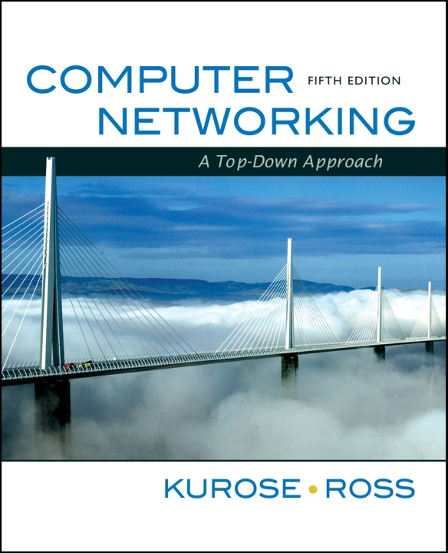
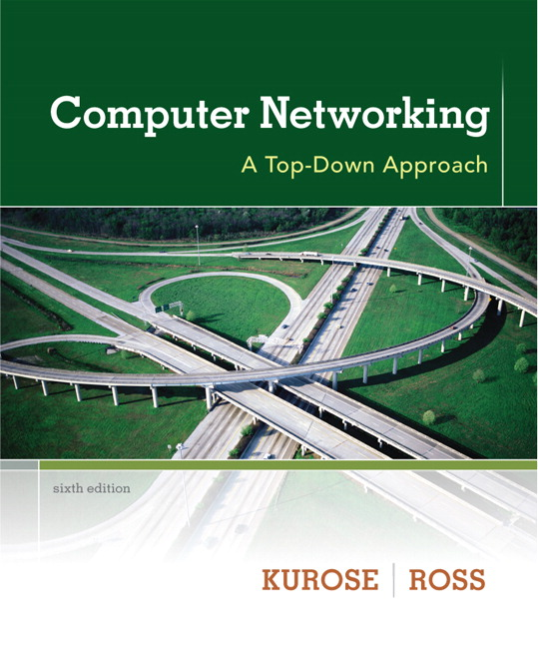
Chapter 6
Wireless and Mobile Networks
Computer Networking: A Top Down Approach.
Jim Kurose, Keith Ross
Addison-Wesley.

Slide 2
Elements of a wireless network
wireless hosts
laptop, PDA, IP phone
run applications
may be stationary (non-mobile) or mobile
  wireless does not always mean mobility
network
infrastructure

Slide 3
Wireless network taxonomy
single hop
multiple hops
host connects to
base station (WiFi,
WiMAX, cellular)
which connects to
larger Internet
host may have to
relay through several
wireless nodes to
connect to larger
Internet: mesh net
infrastructure
(e.g., APs)
no base station, no
connection to larger
Internet. May have to
relay to reach other
a given wireless node
MANET, VANET
no
infrastructure
no base station, no
connection to larger
Internet (Bluetooth,
ad hoc nets)
Mobile Adhoc Networks
Wireless Sensor Networks (WSNs)
Delay Tolerant Networks (DTNs)
Vehicular Adhoc Networks

Slide 4
Wireless Communication Systems & Networking
What complicates wireless networking vs. wired networking?

Slide 5
1- Channel characteristics
  for satellite we get extended propagation delays
  high bit error rate ‘BER’ (higher than optical fiber and coax.)
  asymmetry in bandwidth and delay
  unidirectional links
  effects of wave propagation, attenuation,… etc.
2- Mobility: continuous and introduces topology dynamics
3- Power constraints in lots of the wireless devices

Slide 6
IEEE 802.11: multiple access
avoid collisions: 2⁺ nodes transmitting at same time
802.11: CSMA - sense before transmitting
  don’t collide with ongoing transmission by other node
802.11: no collision detection!
  difficult to receive (sense collisions) when transmitting due to weak received signals (fading)
  can’t sense all collisions in any case: hidden terminal, fading
  goal: avoid collisions: CSMA/C(ollision)A(voidance)
A
B
C
C
A’s signal
strength
C’s signal
strength
B
A
space

Slide 7
Avoiding collisions: RTS/CTS
idea: allow sender to “reserve” channel rather than random access of data frames: avoid collisions of long data frames
sender first transmits small request-to-send (RTS) packets to BS using CSMA
  RTSs may still collide with each other (but they’re short)
BS broadcasts clear-to-send (CTS) in response to RTS
RTS heard by all nodes
  sender transmits data frame
  other stations defer transmissions
avoid data frame collisions completely
using small reservation packets!

Slide 8
Collision Avoidance: RTS-CTS exchange
A
B
AP
RTS(B)
RTS(A)
reservation collision
RTS(A)
CTS(A)
CTS(A)
DATA (A)
defer
time
ACK(A)
ACK(A)

Slide 9
802.11: mobility within same subnet
H1 remains in same IP subnet: IP address can remain same
switch: which AP is associated with H1?
  self-learning (Ch. 5): switch will see frame from H1 and “remember” which switch port can be used to reach H1
router
hub or
switch
BBS 1
AP 1
AP 2
H1
BBS 2

Slide 10
802.11: advanced capabilities
Rate Adaptation
base station, mobile dynamically change transmission rate (physical layer modulation technique) as mobile moves, SNR varies
10⁻¹
10⁻²
10⁻³
BER
10⁻⁴
10⁻⁵
10⁻⁶
10⁻⁷
10
20
30
40
SNR(dB)
1. SNR decreases, BER increase as node moves away from base station
QAM256 (8 Mbps)
QAM16 (4 Mbps)
2. When BER becomes too high, switch to lower transmission rate but with lower BER
BPSK (1 Mbps)
operating point
Rate adaptation can change rate from
100Mbps to 1Mbps !!
Does this affect higher protocol layers?

Slide 11

Components of cellular network architecture
MSC
connects cells to wide area net
manages call setup (more later!)
handles mobility (more later!)
cell
covers geographical region
base station (BS) analogous to 802.11 AP
mobile users attach to network through BS
air-interface: physical and link layer protocol between mobile and BS
Mobile
Switching
Center
Public telephone
network, and
Internet
Mobile
Switching
Center
wired network

Slide 12
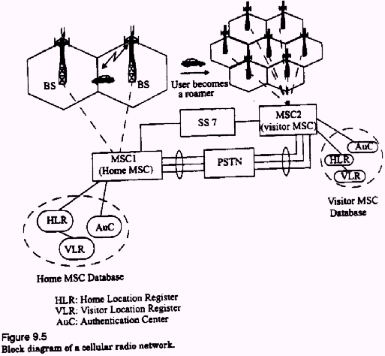

Slide 13
Cellular Comm./Networking Terminology
Hand-off: the process of transferring the mobile from one base station to another
Roamer: a mobile operating in a coverage area other than the one in which it subscribed (moving to another MSC)

Slide 14
Design concepts: The Cellular Concept and Frequency Re-use
The cellular concept was introduced to solve the problem of frequency limitation (or spectral congestion) and user capacity
Replace a single high power base station with several lower power base stations, each covering a smaller geographical area, a ‘cell’.
Each of the base stations is allocated a number of channels (portion of the overall system channels)

Slide 15
Cluster
B
G
C
B
Cell
A
G
C
B
F
D
A
G
C
E
F
D
A
B
E
F
D
G
C
B
E
A
G
C
F
D
A
E
F
D
E
Cellular frequency re-use concept: cells with the same letter use the same set of frequencies.
A cluster of cells (highlighted in bold) is replicated over the coverage area. The cluster size,
N, is equal to 7. Since each cell contains one-seventh of the overall channels, the cell
frequency re-use factor is 1/7.
This requires channel/frequency planning and allocation!

Slide 16
Channel assignment strategies
Channel assignment affects handoff
(1) Fixed Assignment:
  Each cell is allocated a pre-determined set of channels or frequencies
  If a call request is made and no available channels exist, then it will be blocked (may lead to high blocking probability)
The notion of ‘borrowing’ may be used to alleviate blocking.

Slide 17
(2) Dynamic Assignment:
  channels allocated on-demand
Reduces blocking (similar in concept to the shared buffer switch)
Requires that the MSC collects real-time iformation about channel occupancy, traffic distribution, radio signal strength indications (RSSI), periodically for all channels

Slide 18
Hand-off strategies
Mobile moves into a different cell
It monitors the signal strength from the current base station
When power drops below a certain threshold we need hand off

Slide 19
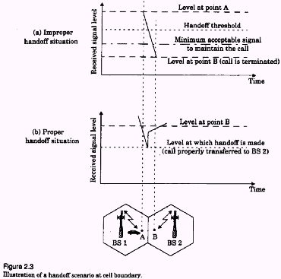

Slide 20
During handoff: to avoid call termination, allow a safety margin
  Δ=Power__{handoff} – Power__{min usable}
Note:
  Does handoff occur only during movement?
  Even if the mobile is stationary, the signal strength may vary
  with changes in the surrounding environment, so we may need
  a handoff

Slide 21
Handoff in 1st generation:
  Strength of signal measurement is done by the base station and supervised by MSC
Hand off in 2nd generation:
In TDMA: it is mobile assisted handoff (MAHO).
  Every mobile measures the strength of signal to base stations and reports to the serving base station
  Mobile performs measurement during idle time slots

Slide 22
In CDMA: (code division multiple access)
  Soft handoff:
  No change of channel, only change of base station
  The cells use the same frequency and channels
[More later when we talk about CDMA/TDMA]

Slide 23

Interference in Cellular Networks
Main types on interference:
  ‘Co-channel’ interference
  ‘Adjacent channel’ interference
  External sources
  Effects of fading
  …

Slide 24
Co-channel Interference
Exists between signals from co-channel cells (in different clusters)
Co-channel cells are those cells that use the same set of frequencies
Co-channel interference cannot be reduced by strengthening the signal.

Slide 25
It is a function of the radius of the cell (R) and the distance between centers of the nearest co-channel cells (D)
Q=D/R, “Q: channel re-use ratio”
As Q increases, the spatial separation between co-channels relative to the cell size increases, so interference decreases

Slide 26
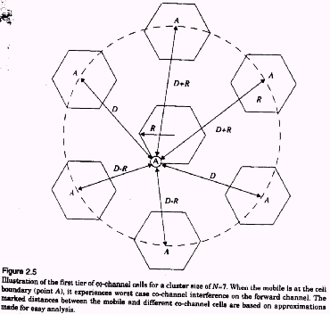
Illustration of co-channel cells for a cluster size of N=7.
When the mobile is at the cell boundary (A), it experiences
worst case co-channel interference on the forward channel.

Slide 27
Adjacent Channel Interference
Signals that occupy frequency spectrum adjacent to the desired signal, may cause interference due to imperfect filtering (at the receivers).
The worst interference occurs when the adjacent frequencies are used within the same cell
Can be reduced by filtering and careful channel assignment

Slide 28
(1) Channel assignment in a cell:
  Instead of assigning channels from a contiguous band of frequencies
  Channels are assigned such that frequency separations between channels are maximized.
  For example, by sequentially assigning adjacent bands to different cells
  This is called ‘frequency planning’.
(2) A filter is used in the base station to reject power from adjacent channels.

Slide 29
1
2
3
4
5
6
7
8
9
10
11
12
13
14
freq
B
2
9
G
4
C
5
11
12
1
A
8
F
6
D
7
13
14
E
3
10
Frequency Planning/Channel Assignment

Slide 30
Multiple Access (MA) Techniques for Wireless Communications
MA schemes allow multiple mobile users to share a limited frequency spectrum.
Main MA schemes: FDMA, TDMA, SSMA (FHMA, CDMA [DSMA]), SDMA

Slide 31
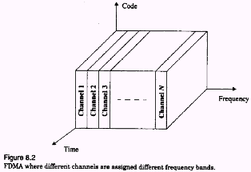
FDMA

Slide 32
Frequency Division Multiple Access (FDMA)
Assigns individual channels to individual users on demand
Only 1 user utilizes the channel at a time. Idle times are wasted. Capacity is not shared.
Communication is continuous
Does not need synchronization
Costly filters at the base station
Need guard bands to alleviate interference

Slide 33
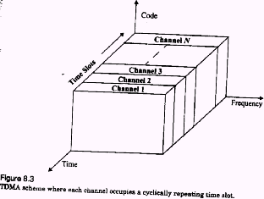
TDMA

Slide 34
Time Division Multiple Access (TDMA)
In a time slot only 1 user transmits (or receives)
Several users share a single frequency channel
Transmission is non-continuous
Power consumption is lower than FDMA (e.g., the transmitter can be turned off when idle)
During idle time, a mobile performs MAHO
Synchronization is needed

Slide 35
Spread Spectrum Multiple Access (SSMA)
Traditional communication techniques
  Strive to conserve bandwidth
By contrast, Spread spectrum techniques
  use bandwidth several orders of magnitude larger than the min. required bandwidth !!

Slide 36
Spread Spectrum Multiple Access (SSMA)
Spread spectrum techniques use bandwidth larger than the min. required bandwidth
Modulation:
  Uses pseudo-noise (PN) sequence to convert the signal into wideband
  The PN is random, but can be re-produced by receiver
Demodulation:
  Correct correlation using a PN re-produces the signal
  Using wrong PN sequence produces noise, hence this scheme is ‘secure’

Slide 37
Code Division Multiple Access (CDMA)
used in several wireless broadcast channels (cellular, satellite, etc) standards
unique “code” assigned to each user; i.e., code set partitioning
all users share same frequency, but each user has own “chipping” sequence (i.e., code) to encode data
encoded signal = (original data) X (chipping sequence)
decoding: inner-product of encoded signal and chipping sequence
allows multiple users to “coexist” and transmit simultaneously with minimal interference (if codes are “orthogonal”)

Slide 38
Speading the signal power over a wide spread of the frequency spectrum reduces fading effects
  only part of the spectrum, hence only part of the signal, is affected by fading
No frequency planning required since users use the same frequency
Soft hand-off can be provided since all the cells use the same frequency. MSC monitors signals.
In soft hand-off the channel (or frequency) remains the same and the base station changes

Slide 39
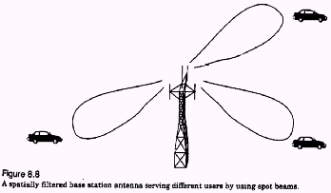
Space Division MA (SDMA)
Controls the radiated energy for each user in space using spot beam (directional) antennas

Slide 40
Hybrid Multiple Access Systems
Time division frequency hopping (TDFH): (used in some versions of GSM)
User can hop to new frequency at the start of a new TDMA frame
Hence reducing interference and fading effects
User hops over pre-defined frequencies

Slide 41
Mobility: Vocabulary
home network: permanent “home” of mobile
(e.g., 128.119.40/24)
home agent: entity that will perform mobility functions on behalf of mobile, when mobile is remote
wide area network
Permanent address: address in home network, can always be used to reach mobile
e.g., 128.119.40.186
correspondent

Slide 42
Mobility: more vocabulary
visited network: network in which mobile currently resides (e.g., 79.129.13/24)
Permanent address: remains constant (e.g., 128.119.40.186)
Care-of-address: address in visited network.
(e.g., 79,129.13.2)
wide area network
foreign agent: entity in visited network that performs mobility functions on behalf of mobile.
correspondent: wants to communicate with mobile

Slide 43
Mobility: approaches
Let routing handle it: routers advertise permanent address of mobile-nodes-in-residence via usual routing table exchange.
  routing tables indicate where each mobile located
  no changes to end-systems
Let end-systems handle it:
  indirect routing: communication from correspondent to mobile goes through home agent, then forwarded to remote
  direct routing: correspondent gets foreign address of mobile, sends directly to mobile

Slide 44
Mobility: approaches
Let routing handle it: routers advertise permanent address of mobile-nodes-in-residence via usual routing table exchange.
  routing tables indicate where each mobile located
  no changes to end-systems
let end-systems handle it:
  indirect routing: communication from correspondent to mobile goes through home agent, then forwarded to remote
  direct routing: correspondent gets foreign address of mobile, sends directly to mobile
not
scalable
to millions of
mobiles

Slide 45
Mobility: registration
visited network
home network
1
2
wide area network
mobile contacts foreign agent on entering visited network
foreign agent contacts home agent home: “this mobile is resident in my network”
End result:
Foreign agent knows about mobile
Home agent knows location of mobile

Slide 46
Mobility via Indirect Routing
foreign agent receives packets, forwards to mobile
home agent intercepts packets, forwards to foreign agent
visited
network
home
network
3
wide area network
2
1
correspondent addresses packets using home address of mobile
4
mobile replies directly to correspondent

Slide 47
Mobility via Direct Routing
foreign agent receives packets, forwards to mobile
correspondent forwards to foreign agent
visited
network
home
network
4
wide area network
2
3
correspondent requests, receives foreign address of mobile
1
4
mobile replies directly to correspondent

Slide 48
Drawbacks of Mobile IP
Other than (the main problem) of triangular routing
  Mobile IP incurs lots of communication with the home agent with every movement
  so, may not be fit for ‘micro’ mobility [e.g., move between rooms or buildings within the same network domain]
  handoff delays are significant since registration/packets need to go through the home agent first

Slide 49
Suggested solutions
To avoid triangular routing
  use ‘route optimization’
  use micro-mobility architectures
    Cellular IP (CIP)
    Hawaii
    Multicast-based Mobility (M&M)

Slide 50
Micro-Mobility
Hierarchical approach to mobility:
  During frequent, intra-domain, movement only local efficient handoff is performed without notifying the home agent (HA) or the correspondent node (CN)
  For inter-domain mobility use Mobile IP. Notify HA or CN only during inter-domain movement

Slide 51
Distribution tree dynamics while roaming
Domain Root
FA or CN
Wireless link
Mobile Node

Slide 52
M&M: Join/Prune dynamics to modify distribution
Domain Root
Wireless link
Mobile Node

Slide 53
Components of cellular network architecture
recall:
correspondent
wired public telephone
network
MSC
MSC
MSC
MSC
MSC
different cellular networks,
operated by different providers

Slide 54
Handling mobility in cellular networks
home network: network of cellular provider you subscribe to (e.g., Sprint PCS, Verizon)
  home location register (HLR): database in home network containing permanent cell phone #, profile information (services, preferences, billing), information about current location (could be in another network)
visited network: network in which mobile currently resides
  visitor location register (VLR): database with entry for each user currently in network
  could be home network

Slide 55
GSM: indirect routing to mobile
HLR
home
network
2
correspondent
home
Mobile
Switching
Center
home MSC consults HLR,
gets roaming number of
mobile in visited network
1
call routed
to home network
3
Public switched
telephone
network
VLR
Mobile
Switching
Center
4
home MSC sets up 2nd leg of call
to MSC in visited network
mobile
user
MSC in visited network completes
call through base station to mobile
visited
network

Slide 56
Mobility: GSM versus Mobile IP
GSM element |  | Comment on GSM element | Mobile IP element
Home system | Network to which mobile user’s permanent phone number belongs |  |  | Home network
Gateway Mobile Switching Center, or “home MSC”. Home Location Register (HLR) | Home MSC: point of contact to obtain routable address of mobile user. HLR: database in home system containing permanent phone number, profile information, current location of mobile user, subscription information |  |  | Home agent
Visited System | Network other than home system where mobile user is currently residing |  |  | Visited network
Visited Mobile services Switching Center. Visitor Location Record (VLR) | Visited MSC: responsible for setting up calls to/from mobile nodes in cells associated with MSC. VLR: temporary database entry in visited system, containing subscription information for each visiting mobile user |  |  | Foreign agent
Mobile Station Roaming Number (MSRN), or “roaming number” | Routable address for telephone call segment between home MSC and visited MSC, visible to neither the mobile nor the correspondent. |  |  | Care-of-address

