Slide 1

Chapter 3
Transport Layer
Computer Networking: A Top Down Approach,
5th edition.
Jim Kurose, Keith Ross
Addison-Wesley, April 2009.
Computer Networking: A Top Down Approach
4th edition.
Jim Kurose, Keith Ross
Addison-Wesley, July 2007.

Slide 2

Internet transport-layer protocols
reliable, in-order delivery to app: TCP
  congestion control
  flow control
  connection setup
unreliable, unordered delivery to app: UDP
  no-frills extension of “best-effort” IP
services not available:
  delay guarantees
  bandwidth guarantees
application
transport
network
data link
physical
network
data link
physical
network
data link
physical
logical end-end transport
network
data link
physical
network
data link
physical
network
data link
physical
network
data link
physical
application
transport
network
data link
physical

Slide 3
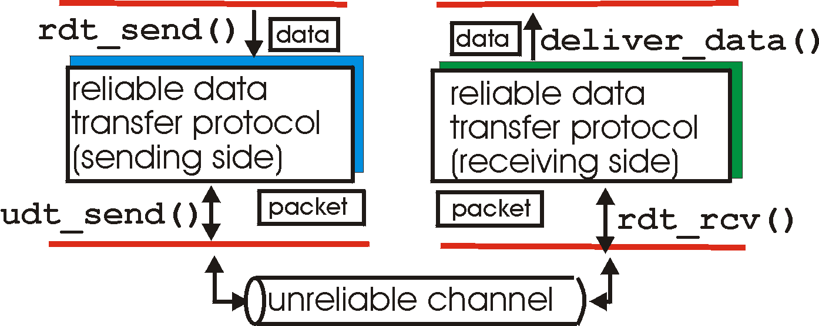
Reliable data transfer: getting started
rdt_send(): called from above, (e.g., by app.). Passed data to
deliver to receiver upper layer
deliver_data(): called by rdt to deliver data to upper
send
side
receive
side
udt_send(): called by rdt,
to transfer packet over
unreliable channel to receiver
rdt_rcv(): called when packet arrives on rcv-side of channel

Slide 4
Hop-by-hop flow control
Approaches/techniques for hop-by-hop flow control
  Stop-and-wait
  sliding window
    Go back N
    Selective reject

Slide 5
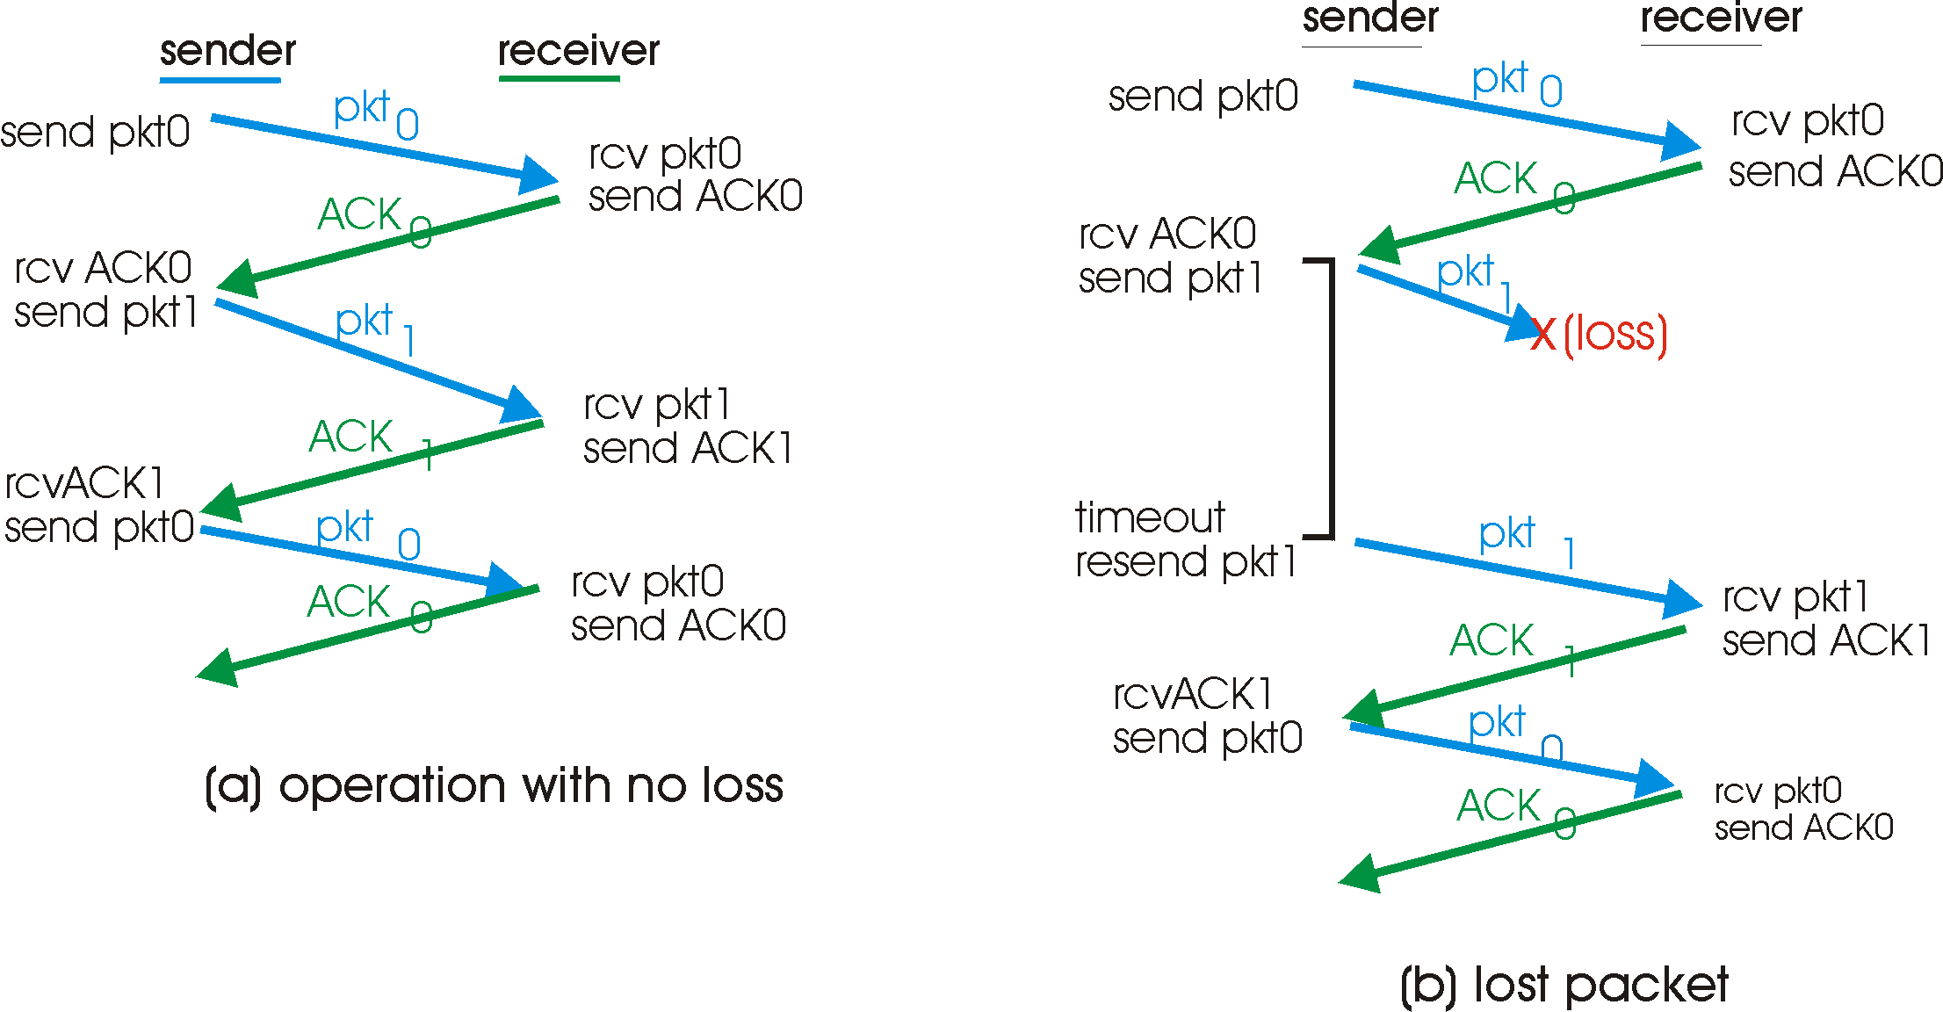
Stop-and-wait with lost packet/frame

Slide 6
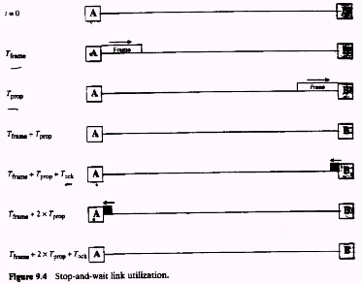

Slide 7
Stop and wait performance
utilization – fraction of time sender busy sending
ideal case (error free)
  u=Tframe/(Tframe+2Tprop)=1/(1+2a), a=Tprop/Tframe

Slide 8
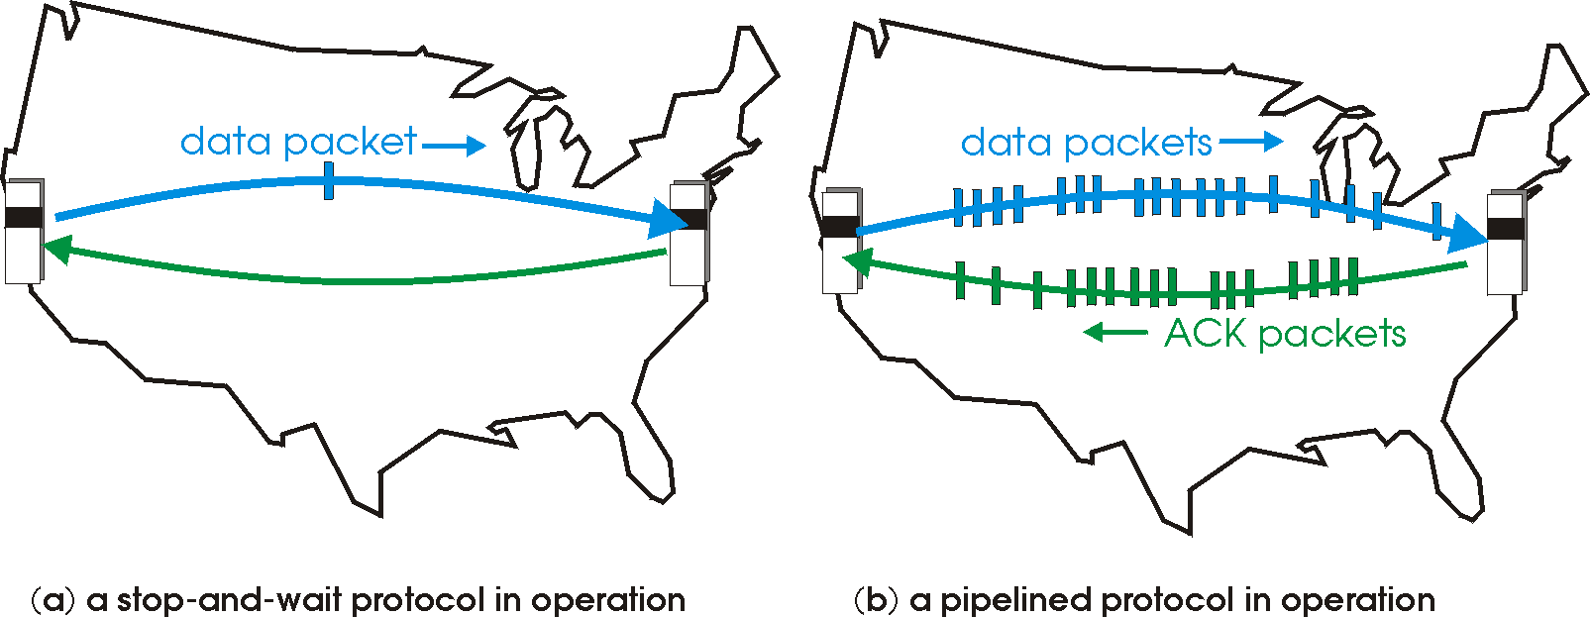
Pipelined (sliding window) protocols
Pipelining: sender allows multiple, “in-flight”, yet-to-be-acknowledged pkts
  range of sequence numbers must be increased
  buffering at sender and/or receiver
Two generic forms of pipelined protocols: go-Back-N, selective repeat

Slide 9
Pipelining: increased utilization
sender
receiver
first packet bit transmitted, t = 0
last bit transmitted, t = L / R
first packet bit arrives
RTT
last packet bit arrives, send ACK
last bit of 2nd packet arrives, send ACK
last bit of 3rd packet arrives, send ACK
ACK arrives, send next
packet, t = RTT + L / R
Increase utilization
by a factor of 3!

Slide 10
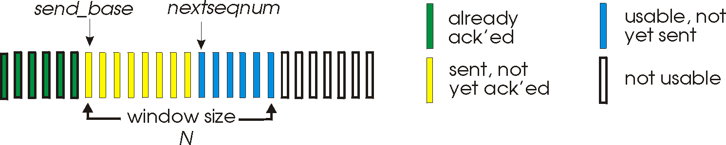
Go-Back-N
Sender:
k-bit seq # in pkt header
“window” of up to N, consecutive unack’ed pkts allowed
ACK(n): ACKs all pkts up to, including seq # n - “cumulative ACK”
  may receive duplicate ACKs (more later…)
timer for each in-flight pkt
timeout(n): retransmit pkt n and all higher seq # pkts in window

Slide 11
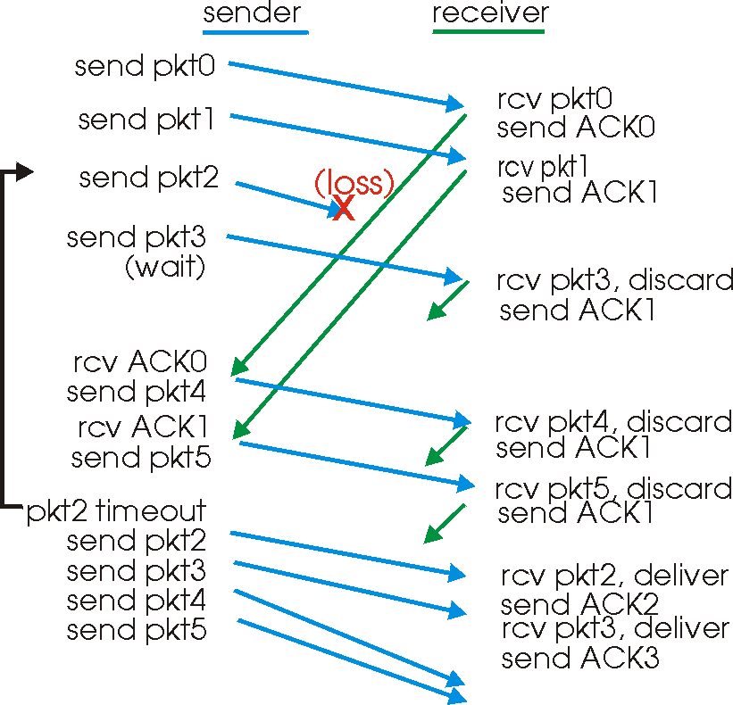
GBN in action

Slide 12
Selective Repeat
receiver individually acknowledges all correctly received pkts
  buffers pkts, as needed, for eventual in-order delivery to upper layer
sender only resends pkts for which ACK not received
  sender timer for each unACKed pkt
sender window
  N consecutive seq #’s
  limits seq #s of sent, unACKed pkts

Slide 13
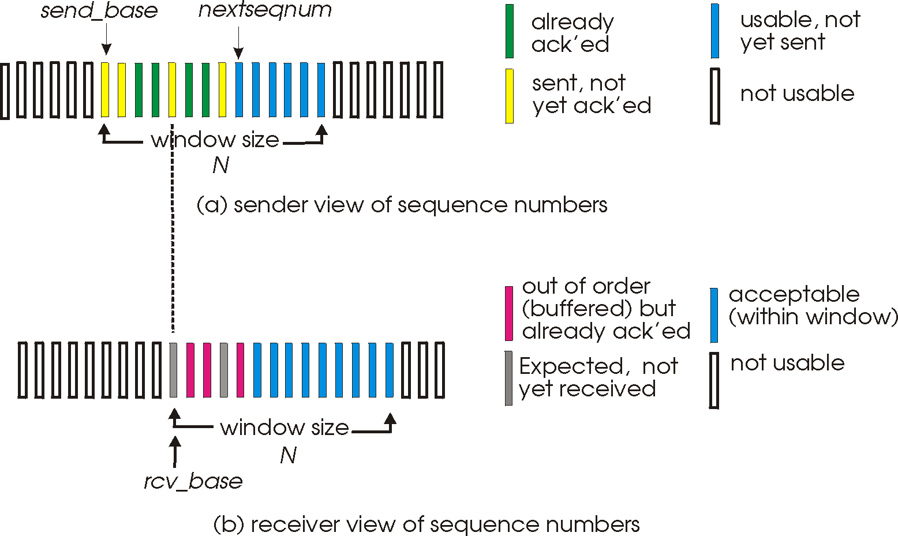
Selective repeat: sender, receiver windows

Slide 14
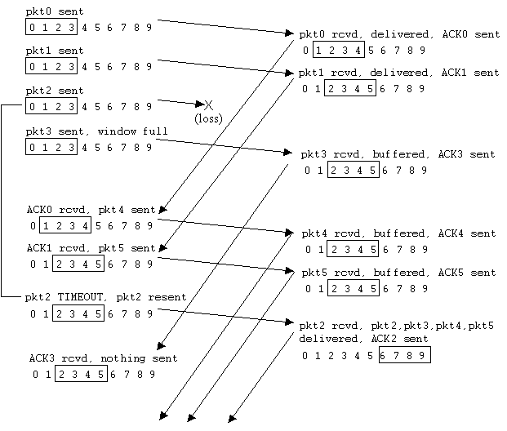
Selective repeat in action

Slide 15
performance:
selective repeat:
  error-free case:
    if the window is w such that the pipe is full→U=100%
    otherwise U=w*Ustop-and-wait=w/(1+2a)
  in case of error:
    if w fills the pipe U=1-p
    otherwise U=w*Ustop-and-wait=w(1-p)/(1+2a)

Slide 16
TCP: Overview RFCs: 793, 1122, 1323, 2018, 2581
point-to-point:
  one sender, one receiver
reliable, in-order byte stream:
  no “message boundaries”
pipelined:
  TCP congestion and flow control set window size
send & receive buffers
full duplex data:
  bi-directional data flow in same connection
  MSS: maximum segment size
connection-oriented:
  handshaking (exchange of control msgs) init’s sender, receiver state before data exchange
flow controlled:
  sender will not overwhelm receiver

Slide 17
TCP segment structure
32 bits
URG: urgent data
(generally not used)
counting
by bytes
of data
(not segments!)
source port #
dest port #
sequence number
ACK: ACK #
valid
acknowledgement number
head
len
not
used
U
Receive window
A
P
R
S
PSH: push data now
(generally not used)
F
# bytes
rcvr willing
to accept
checksum
Urg data pnter
RST, SYN, FIN:
connection estab
(setup, teardown
commands)
Options (variable length)
application
data
(variable length)
Internet
checksum
(as in UDP)

Slide 18
Reliability in TCP
Components of reliability
  1. Sequence numbers
  2. Retransmissions
  3. Timeout Mechanism(s): function of the round trip time (RTT) between the two hosts (is it static?)

Slide 19
TCP Round Trip Time and Timeout
EstimatedRTT(k) = (1- α)*EstimatedRTT(k-1) + α*SampleRTT(k)
=(1- α)*((1- α)*EstimatedRTT(k-2)+ α*SampleRTT(k-1))+ α *SampleRTT(k)
=(1- α)^{k} *SampleRTT(0)+ α(1- α)^{k-1} *SampleRTT)(1)+…+ α *SampleRTT(k)
Exponential weighted moving average (EWMA)
influence of past sample decreases exponentially fast
typical value: α = 0.125

Slide 20
Example RTT estimation:

Slide 21
TCP Round Trip Time and Timeout
Setting the timeout
EstimtedRTT plus “safety margin”
  large variation in EstimatedRTT -> larger safety margin
1. estimate how much SampleRTT deviates from EstimatedRTT:
DevRTT = (1-β)*DevRTT +
β*|SampleRTT-EstimatedRTT|
(typically, β = 0.25)
2. set timeout interval:
TimeoutInterval = EstimatedRTT + 4*DevRTT
  3. For further re-transmissions (if the 1st re-tx was not Ack’ed)
  - RTO=q.RTO, q=2 for exponential backoff
  - similar to Ethernet CSMA/CD backoff

Slide 22
TCP reliable data transfer
TCP creates reliable service on top of IP’s unreliable service
Pipelined segments
Cumulative acks
TCP uses single retransmission timer
Retransmissions are triggered by:
  timeout events
  duplicate acks
Initially consider simplified TCP sender:
  ignore duplicate acks
  ignore flow control, congestion control

Slide 23
TCP: retransmission scenarios
Host A
Host B
Host A
Host B
Seq=92, 8 bytes data
Seq=92, 8 bytes data
Seq=100, 20 bytes data
timeout
ACK=100
Seq=92 timeout
X
ACK=100
loss
ACK=120
Seq=92, 8 bytes data
Sendbase
= 100
Seq=92, 8 bytes data
SendBase
= 120
Seq=92 timeout
ACK=120
ACK=100
SendBase
= 100
SendBase
= 120
premature timeout
time
time
lost ACK scenario

Slide 24
TCP retransmission scenarios (more)
Host A
Host B
Seq=92, 8 bytes data
ACK=100
timeout
Seq=100, 20 bytes data
X
loss
SendBase
= 120
ACK=120
time
Cumulative ACK scenario

Slide 25
Fast Retransmit
Time-out period often relatively long:
  long delay before resending lost packet
Detect lost segments via duplicate ACKs.
  Sender often sends many segments back-to-back
  If segment is lost, there will likely be many duplicate ACKs.
If sender receives 3 ACKs for the same data, it supposes that segment after ACKed data was lost:
  fast retransmit: resend segment before timer expires

Slide 26
(Self-clocking)

Slide 27
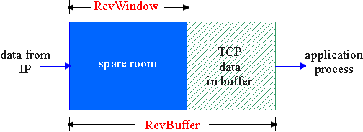
TCP Flow Control
flow control
sender won’t overflow
receiver’s buffer by
transmitting too much, too fast
receive side of TCP connection has a receive buffer:
match the send rate to the receiving app’s drain rate
app process may be slow at reading from buffer (low drain rate)

Slide 28
Principles of Congestion Control
Congestion:
informally: “too many sources sending too much data too fast for network to handle”
different from flow control!
manifestations:
  lost packets (buffer overflow at routers)
  long delays (queueing in router buffers)
a key problem in the design of computer networks

Slide 29
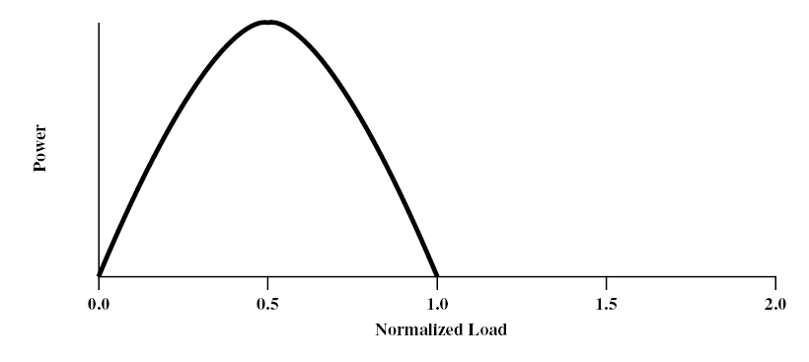
congestion phases and effects
ideal case: infinite buffers,
  Tput increases with demand & saturates at network capacity
Delay
Tput/Gput
Network Power = Tput/delay
Representative of Tput-delay design trade-off

Slide 30
practical case: finite buffers, loss
no congestion --> near ideal performance
overall moderate congestion:
  severe congestion in some nodes
  dynamics of the network/routing and overhead of protocol adaptation decreases the network Tput
severe congestion:
  loss of packets and increased discards
  extended delays leading to timeouts
  both factors trigger re-transmissions
  leads to chain-reaction bringing the Tput down

Slide 31
(I)
(II)
(III)
(I) No Congestion
(II) Moderate Congestion
(III) Severe Congestion (Collapse)
What is the best operational point and how do we get (and stay) there?

Slide 33
Congestion Control (CC)
Congestion is a key issue in network design
various techniques for CC
1.Back pressure
  hop-by-hop flow control (X.25, HDLC, Go back N)
  May propagate congestion in the network
2.Choke packet
  generated by the congested node & sent back to source
  example: ICMP source quench
  sent due to packet discard or in anticipation of congestion

Slide 34
Congestion Control (CC) (contd.)
3.Implicit congestion signaling
  used in TCP
  delay increase or packet discard to detect congestion
  may erroneously signal congestion (i.e., not always reliable) [e.g., over wireless links]
  done end-to-end without network assistance
  TCP cuts down its window/rate

Slide 35
Congestion Control (CC) (contd.)
4.Explicit congestion signaling
  (network assisted congestion control)
  gets indication from the network
    forward: going to destination
    backward: going to source
  3 approaches
    Binary: uses 1 bit (DECbit, TCP/IP ECN, ATM)
    Rate based: specifying bps (ATM)
    Credit based: indicates how much the source can send (in a window)

Slide 36
TCP congestion control: additive increase, multiplicative decrease
Approach: increase transmission rate (window size), probing for usable bandwidth, until loss occurs
  additive increase: increase rate (or congestion window) CongWin until loss detected
  multiplicative decrease: cut CongWin in half after loss
Saw tooth
behavior: probing
for bandwidth
congestion window size
time

Slide 37
TCP Congestion Control: details
sender limits transmission:
LastByteSent-LastByteAcked
≤ CongWin
Roughly,
CongWin is dynamic, function of perceived network congestion
How does sender perceive congestion?
loss event = timeout or duplicate Acks
TCP sender reduces rate (CongWin) after loss event
three mechanisms:
  AIMD
  slow start
  conservative after timeout events
CongWin
rate =
Bytes/sec
RTT

Slide 38
TCP congestion control
Initially we use Slow start:
CongWin = CongWin + 1 with every Ack
When timeout occurs we enter congestion avoidance:
  ssthresh=CongWin/2, CongWin=1
  slow start until ssthresh, then increase ‘linearly’
  CongWin=CongWin+1 with every RTT, or
  CongWin=CongWin+1/CongWin for every Ack
additive increase, multiplicative decrease (AIMD)

Slide 40
Slow start
Exponential increase
Congestion Avoidance
Linear increase
CongWin
(RTT)

Slide 41
Fast Retransmit & Recovery
Fast retransmit:
  receiver sends Ack with last in-order segment for every out-of-order segment received
  when sender receives 3 duplicate Acks it retransmits the missing/expected segment
Fast recovery: when 3rd dup Ack arrives
  ssthresh=CongWin/2
  retransmit segment, set CongWin=ssthresh+3
  for every duplicate Ack: CongWin=CongWin+1
  (note: beginning of window is ‘frozen’)
  after receiver gets cumulative Ack: CongWin=ssthresh
  (beginning of window advances to last Ack’ed segment)
CongWin

Slide 43
TCP Fairness
Fairness goal: if K TCP sessions share same bottleneck link of bandwidth R, each should have average rate of R/K
TCP connection 1
TCP
connection 2
bottleneck
router
capacity R

Slide 44
Fairness (more)
Fairness and UDP
Multimedia apps often do not use TCP
  do not want rate throttled by congestion control
Instead use UDP:
  pump audio/video at constant rate, tolerate packet loss
Research area: TCP friendly protocols!
Fairness and parallel TCP connections
nothing prevents app from opening parallel connections between 2 hosts.
Web browsers do this
Example: link of rate R supporting 9 connections;
  new app asks for 1 TCP, gets rate R/10
  new app asks for 11 TCPs, gets R/2 !

Slide 45
TCP and Network Dynamics
TCP operates end-to-end and is unaware of routing changes
Loss can occur due to link failures and path changes
When routes heal, paths change with potential adverse effects on TCP
Going from high bandwidth-delay product (bw.del) to a low bw.del can result in TCP losses. Why? (see animation)

Slide 46
Congestion Control with Explicit Notification
TCP uses implicit signaling
ATM (ABR) uses explicit signaling using RM (resource management) cells
ATM: Asynchronous Transfer Mode, ABR: Available Bit Rate
ABR Congestion notification and congestion avoidance
parameters:
  peak cell rate (PCR)
  minimum cell rate (MCR)
  initial cell rate(ICR)

Slide 47
ABR uses resource management cell (RM cell) with fields:
  CI (congestion indication)
  NI (no increase)
  ER (explicit rate)
Types of RM cells:
  Forward RM (FRM)
  Backward RM (BRM)

Slide 49
Congestion Control in ABR
The source reacts to congestion notification by decreasing its rate (rate-based vs. window-based for TCP)
Rate adaptation algorithm:
  If CI=0,NI=0
    Rate increase by factor ‘RIF’ (e.g., 1/16)
    Rate = Rate + PCR/16
  Else If CI=1
    Rate decrease by factor ‘RDF’ (e.g., 1/4)
    Rate=Rate-Rate*1/4

