Slide 1


Welcome

Slide 2
CISE Ph.D. Program
New Student Orientation
January 9th, 2026
Spring 2026 Semester

Slide 3
Please hold all questions until the end
If we do not answer your questions in the presentation, please make note of them. There will be time at the end for questions.

Slide 4
Housekeeping
Notes
Pick up after yourself! Let’s leave this room as we found it.
This presentation will be made available within a week on the Master’s Advising Canvas Course.

Slide 5
Agenda
Student Services Introduction and Overview
Program Overview
Individual Development Plan (IDP) & Supervisory Committees
Academics & Registration
Dissertation, Qualifying Exam, & Admission to Candidacy
CISE Career Fair
Campus Resources
Important Dates

Slide 6

Introduction & Overview

Slide 7
What Student Services (SSC) Does
Course scheduling assistance
Adding and dropping courses
Course withdrawals
Petitions
Supervisory Committees
Academic Problems
Graduation
Internships
…and more!

Slide 8
What SSC is NOT
We are not your UF International Center advisor
  We cannot assist with issues relating to your visa status
We are not the Bursar/OneStop
  We cannot help you make payments toward your tuition
We are not the Health Compliance Office
  We cannot do anything with your medical records or holds
While we are not all of those things, please feel free to contact me, and I will see if I can help you. I am always willing to try to assist you with problems, but I cannot guarantee that I can speed up responses from other offices

Slide 9
But ultimately…
We are here to help you with your
academic journey, the best way we can!
If you’re not sure where to go or whom to contact,
do not hesitate to reach out to us!

Slide 10
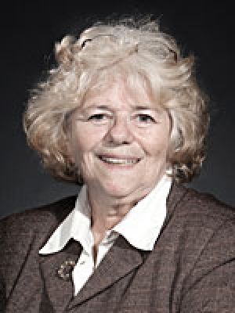
Student Services Staff - Adrienne
Ph.D. Student Academic Advisor
Ph.D. Student Academic Advising
Ph.D. Student Enrollment and Registration
Ph.D. Student Orientation
University Petitions
Transfer Credit Processing for all Graduate Students
Master’s Degree On-The-Way (en route to Ph.D.)
Ph.D. Graduation verification
Plus, much more!

Slide 11
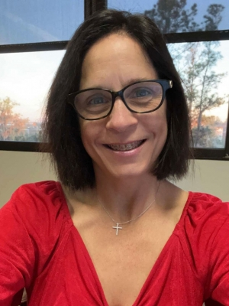
Student Services Staff - Kristina
Admissions Specialist
Graduate Admissions
Senior Certificate
Internships, CPT, OPT
Processing for non-traditional programs
Computer Science Career Fair
Manages the BS + MS program
Recruiting for the Ph.D. program
Plus, much more!

Slide 12
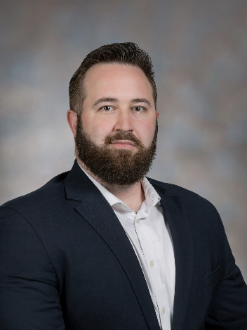
Student Services Staff - Scott
Master’s Student Academic Advisor
Master Student Academic Advising
Master Student Enrollment and Registration
Master Student Orientation
Achievement Award Management
Graduation Certification
Credential Holds
CISE Masters Advising Canvas Module
Plus, much more!

Slide 13
Contacting SSC
For Adrienne L Cook: alcook@ufl.edu
For Kristina Sapp: klsapp@ufl.edu
We are here to help you!

Slide 14
Email Requirements - UFID
YOU MUST INCLUDE YOUR UFID
We CANNOT assist you without it.
We suggest you add your UFID (without the dash)
to your email signature, so you don’t forget it.

Slide 15
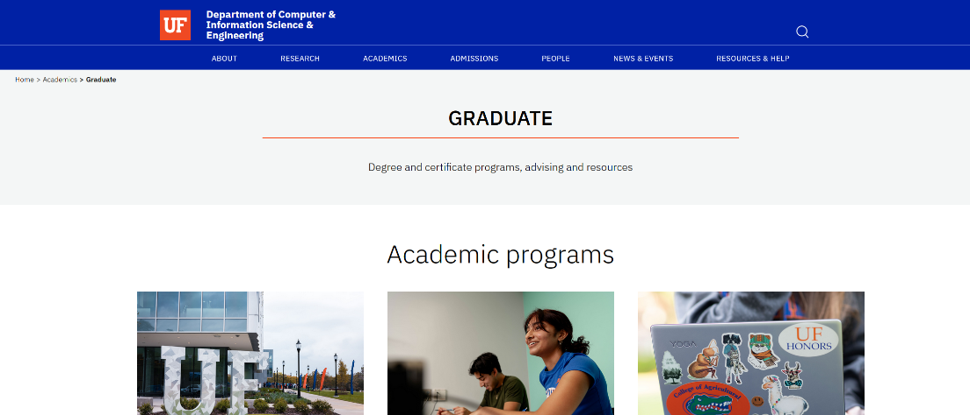
The CISE Department Website
www.cise.ufl.edu/academics/graduate

Slide 16
Program Overview

Slide 17
CISE Graduate Ph.D. Programs
Doctor of Philosophy
Computer Engineering - CEN
Computer Science - CSE
Human-Centered Computing - HCC

Slide 18
Full Course Load
9 credits in fall/spring, 6 in summer
CPT is considered “outside” credits- CPT credits may count toward any grad degree
For information about CTP- please contact Ms. Kristina Sapp at klsapp@ufl.edu

Slide 19
Ph.D. Degree Progress
Complete required coursework
Apply for graduation at the beginning of your last term and complete the exit process (watch for email notification)
For any questions, contact Adrienne L. Cook
Most finish in 5-7 years
More Info: http://www.cise.ufl.edu/academics/grad/phd/index.shtml#csreq

Slide 20
Individual Development Plan (IDP) & Supervisory Committees

Slide 21
IDP
REQUIRED FOR ALL PH.D. STUDENTS IN ALL MAJORS
START HERE: IDP Computer & Information Science Eng (instructure.com)
I am happy to meet with you individually to discuss the IDP.
Please email me at alcook@ufl.edu to schedule an appointment

Slide 22
Supervisory Committees
Ph.D.:
4 members, three from CISE and one external
Please go to the following URL for specific information about this Milestone--Ph.D. Program - Computer & Information Science & Engineering (ufl.edu)
Please note: Some faculty in other departments hold appointments in CISE – these faculty members cannot be external committee members.

Slide 23
Supervisory Committees, cont.
Committees must be formed no later than the end of the second semester
Committees cannot be changed in the final term but can be adjusted at any time until the final term.
I am happy to email the Supervisory Form to you—this can all be done via email, including signatures

Slide 24
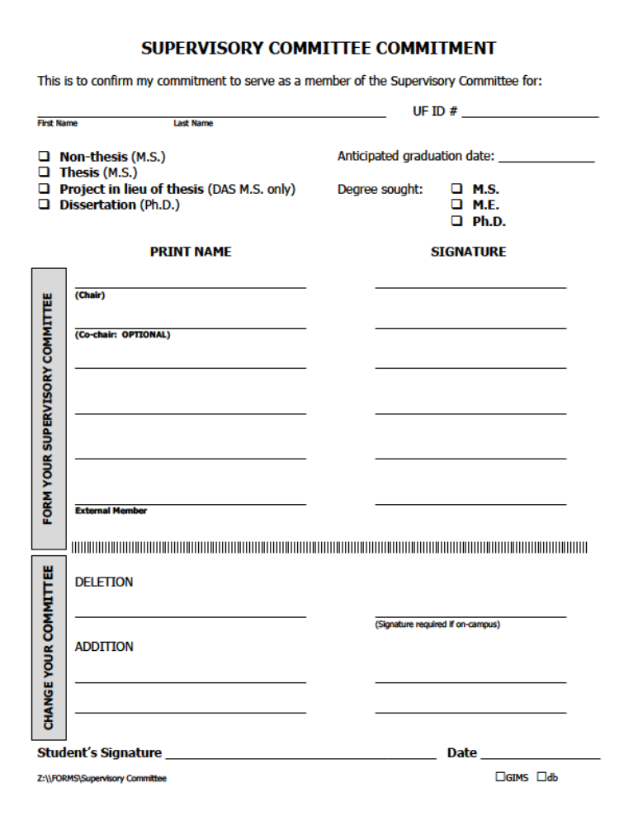
Supervisory Committee Form

Slide 25
Academics & Registration

Slide 26
STRONG RECOMMENDATIONS
First Term—Discuss your proposed schedule with your advisor
  One core course - ⬄ ⬄ ⬄ ⬄
  Research and if your advisor recommends this 1 CISE elective course
      Core courses typically have a heavier workload than elective courses.
      Students tend to have greater success in their first semester if they take only one core course.

Slide 27
Registration
DO NOT REGISTER FOR MORE THAN 9 CREDITS!
Make sure there are no holds on your record
  (ISIS, insurance, financial, credentials, etc.)
Go to ttps://one.uf.edu/ to see the schedule of courses and holds on your record

Slide 28
Registration, cont.
Email me your course selection at alcook@ufl.edu for registration, and I will register you.
Register for 9 (nine) credits. This is a full-time load for most graduate students.
Register for AT LEAST one course by 5 p.m. on Friday, January 9th, to avoid the late registration fee ($100).

Slide 29
Grade Issues
You must have a 3.0 overall grade point average and a 3.0 major GPA to graduate
Students with less than a 3.0 are not considered in good standing
Students with GPAs below a 3.0 will be reviewed by the Graduate Affairs Committee for further action (including possible dismissal) at the end of each semester.

Slide 30
Grade Issues, cont.
ANY grade < C (e.g. C-, D+, etc.) will NOT count toward graduation
A comment on repeating coursework
  This is STRONGLY DISCOURAGED
Undergraduate coursework does not count toward graduation

Slide 31
“I” Grades
If a student fails to complete all of a course’s requirements, the instructor has the option to give a grade of “I” (incomplete)
Most instructors will use this option only if there are extenuating circumstances (family emergency, medical situation, etc.)
An “I” must be made up in the following term.

Slide 32
“I” Grades, cont.
Students cannot sit in on a course to make up an “I” grade
Failure to correct an “I” will result in the grade being calculated as an E for the GPA.
Students are not allowed to graduate with an “I”, “H”, “J”, or “N” on their record.

Slide 33
Transfer of Credit
Ph.D. students with a master’s can transfer up to 30 credits from M.S., plus an additional 15 credits from post-M.S. work.
Ph.D. students without a master’s can transfer in 15 hours of graduate coursework.

Slide 34
Transfer of Credit, cont.
Transfer credit does not satisfy course requirements for Ph.D. programs. It only adds to the hours earned.
Transfer should be done during the first semester.
  Please be sure to email me directly if you believe you may be eligible for transfer credit.

Slide 35
Core Course Equivalency
If you believe that you have taken a course (or courses), including undergraduate course(s), that is equivalent to a core course in our department, you will need to take the following steps:
Obtain a copy of your finalized transcript from your prior institution.
Prepare a copy of the course syllabus and catalog description of the equivalent course(s), as well as any supporting material such as exams, projects, and homework.

Slide 36
Core Course Equivalency, cont.
  Provide these items, along with the equivalency form (I am happy to email the form to you), to the instructor who teaches the core course for determining whether the course can be waived.
  (This can all be done via email—no need for face-to-face meetings.)

Slide 37
Core Course Equivalency, cont.
Remember: This is a different process than transferring prior credits, a process which should be handled, with the help of your grad advisor, early in your first semester.

Slide 38
SPEAK Test
You must score 45 or more on this test to apply in any semester as a “regular” TA
SPEAK test dates this semester can be found at the following URL: http://ase.ufl.edu

Slide 39
Electives Outside of CISE
Ph.D. students: Consult your Committee Chair/Advisor for the program for electives.
MUST obtain Advisor permission before taking the course.
For CPT/Internship information- contact Ms. Kristina Sapp at klsapp@ufl.edu

Slide 40
Registration - Holds
You must make sure ALL your registration holds on ONE.UF are clear to allow you to register.
Not all holds prevent you from registering. Check your holds and what they impact FIRST.

Slide 41
Registration - Holds, cont.
Degree/Credential Verification
  You MUST submit your final degree certificate and transcripts from your undergraduate institution as soon as possible.
  Until it is received and processed, you will NOT be able to register for the next semester. You are OK to register for this semester.

Slide 42
Registration - Holds, cont.
Other Registration Holds:
  Emergency Contact (every 4 months)
  Immunization Hold (UF Health Compliance Office)
  Registration Prep (Each Semester)
  Local Address Information
  Student Insurance (Once a year)
  Financial (past due debts)
It is your responsibility to monitor ONE.UF for these holds and clear them.
Do NOT delay in handling these issues.

Slide 43
Dissertation, Qualifying Exam, & Admission to Candidacy

Slide 44
Qualifying Examination
MUST BE COMPLETED BY THE SIXTH (6) SEMESTER
Refer to the following URL for details: https://www.cise.ufl.edu/academics/grad/qualifying-exam-req
Do not wait until your sixth semester to begin

Slide 45
ADMISSION TO CANDIDACY
AKA, your Proposal
Email Adrienne at least one (1) week prior to your Admission to Candidacy/Proposal with the following information:
Date/Time of your proposal
Title of your Dissertation
PDF of your Abstract
Zoom link for your proposal.

Slide 46
Dissertation
Complete the required research
Apply for graduation at the beginning of the last term and complete the exit process
  Attend graduation meeting at the beginning of the semester you plan to graduate.
Write dissertation
Schedule your defense
Defend dissertation

Slide 47
CISE Career Fair

Slide 48
CISE Career Fair
Make sure you attend the CISE Career Fair!
This is a great opportunity to meet with the many companies that hire our CISE graduate students.
There are many opportunities to volunteer for this event. Emails will be sent with more information.

Slide 49

Career Fair Flyer
For more information
Contact Ms. Sapp: klsapp@ufl.edu
Website: https://careerfair.cise.ufl.edu/

Slide 50

Career Fair Flyer and Volunteering

Slide 51
Campus Resources

Slide 52
Campus Resources
All resources listed are
FREE to UF students

Slide 53
Campus Resources – Highlighted (1)
UF Counseling and Wellness Center (CWC)
  301 Peabody Hall
  https://counseling.ufl.edu
Student Health Care Center
  2140 Stadium Road
  https://shcc.ufl.edu/
University Police Department
  1555 Museum Road
  Non-Emergency Number: 392-1111
  Call 911 for emergencies
Field & Fork Pantry
  https://pantry.fieldandfork.ufl.edu

Slide 54
Campus Resources – Highlighted (2)
UF Disability Resource Center
  https://disability.ufl.edu/
Student Legal Services
  https://studentlegalservices.ufl.edu/
UF Disability Resource Center
  https://disability.ufl.edu/
Student Legal Services
  https://studentlegalservices.ufl.edu/

Slide 55
Campus Resources – Whole Gator
The highlighted resources listed previously are not all the resources available. If you are looking for something not listed, UF has the Whole Gator resource available.
You can locate it in ONE.UF or as an App.
ONE.UF
https://one.uf.edu/whole-gator/topics
Whole Gator App:
https://studentlife.ufl.edu/wholegator/

Slide 56

International Friendship USA
This is an organization that exists to befriend and assist international students and their families during their transition and stay in America – free English classes every week, plus more!
Link:
https://internationalfriendship.org/

Slide 57
Important Dates

Slide 58
Graduate School Calendar
Important Graduate School Deadlines can be found at the following URL:
https://gradcatalog.ufl.edu/graduate/calendar/

Slide 59
Important Dates
Regular Registration: January 9th
  ($100 late fee after 11:59 pm deadline)
Classes Begin: January 12th
Drop/Add: January 12th – 16th
Fee Payments: January 23rd (3:30 pm)

