Slide 1
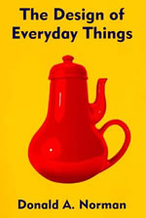

Slide 2
HCI Iconic Book
Don Norman
Worked for industry (Apple)
Professor
First published in 1988
Does not focus on computer interfaces
Coined: user-centered design
Goal:
Motivate us to not accept bad design
Put forth design principles for good design

Slide 3
Why are everyday things so hard to use?
Doors
Design
Telephones
Multiple function buttons
VCRs and Dishwashers
Features
Thermostats
Mental models

Slide 4
Contents
The Psychopathology of Everyday Things
How does a thermostat work?
The Psychology of Everyday Actions
What would assume if all your gauges in your car went out?
Knowledge in the Head and in the World
Typist and keyboards
Knowing What to Do
Affordance
To Err Is Human
Will happen, who gets the blame
The Design Challenge

Slide 5
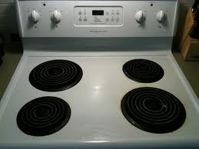
Design of Everyday Things
Affordance, Errors, and Design

Slide 6
Norman Doors

Slide 7
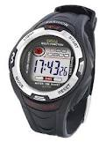
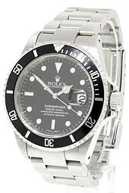
Paradox of Technology
Technology enables more
However it makes good design harder
Watch example
Adding a feature makes interface design harder

Slide 8
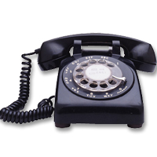
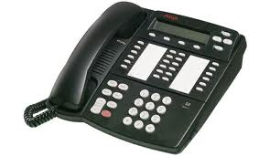
Paradox of Technology
Technology enables more
However it makes good design harder
Phone example
Adding a feature makes interface design harder

Slide 9
Good Design
Visibility – Can I see it?
Feedback – What is it doing?
Affordance – How do I use it?
Conceptual Model – How do I think it works?
Constraints – What can/can’t I do?

Slide 10
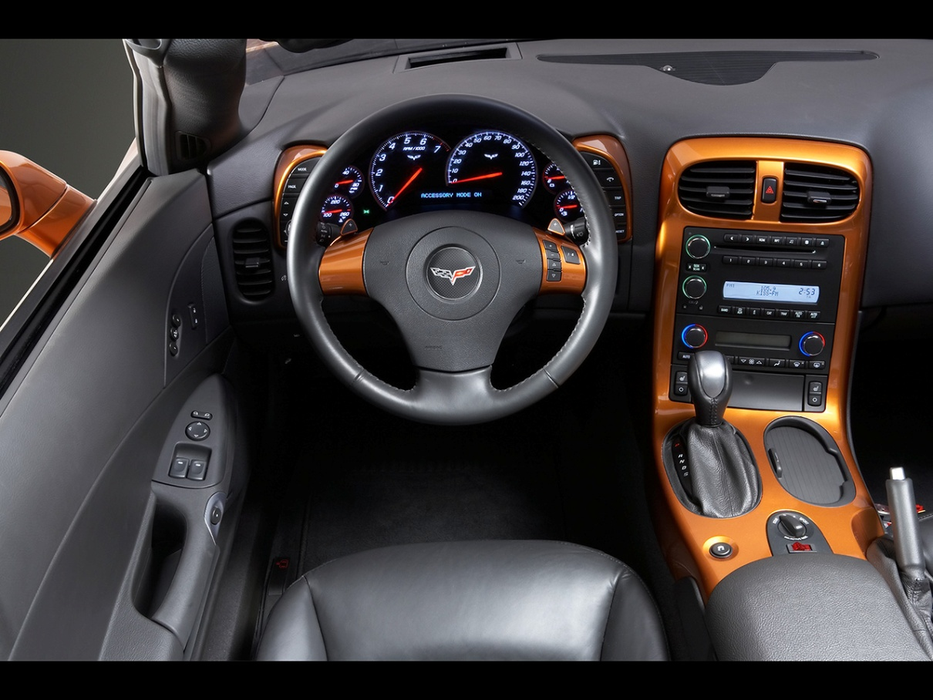
Visibility
State of system
Possible actions

Slide 11
Feedback
What is currently going on
What action has been performed

Slide 12
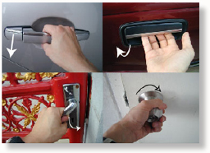
Affordance
What people perceive is possible

Slide 13
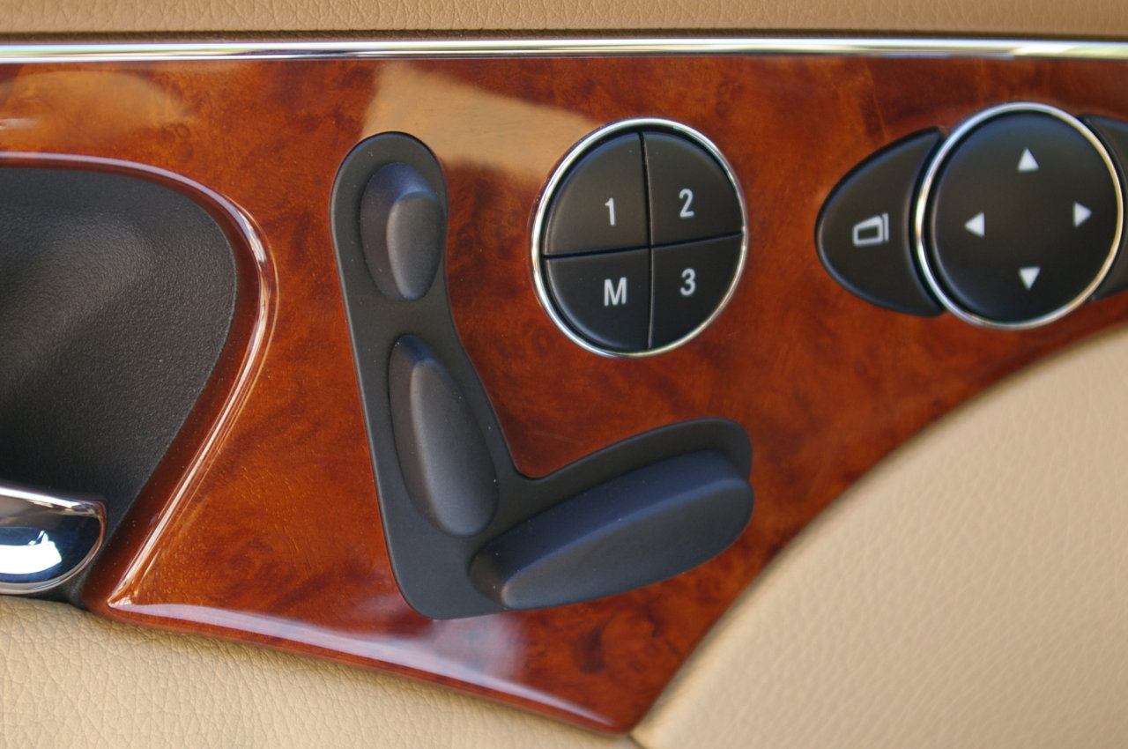
Conceptual Model
How do I think it works?

Slide 14
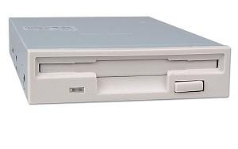
Constraints

Slide 15
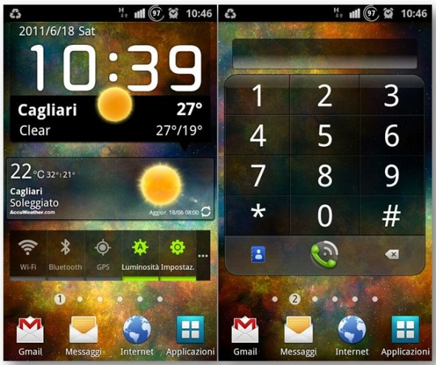
Information
World
Head

Slide 16
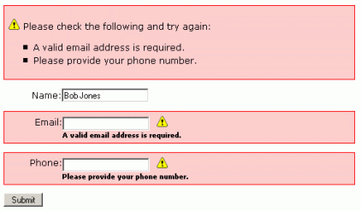
Errors
Users will make errors
Make it easy to recover

Slide 17
Natural Mappings
http://www.usabilitypost.com/2010/11/17/the-design-of-everyday-things/
http://www.ted.com/talks/don_norman_on_design_and_emotion?language=en

