Slide 1
EVALUATING USER INTERFACES
15 & 17 January 2014

Slide 2
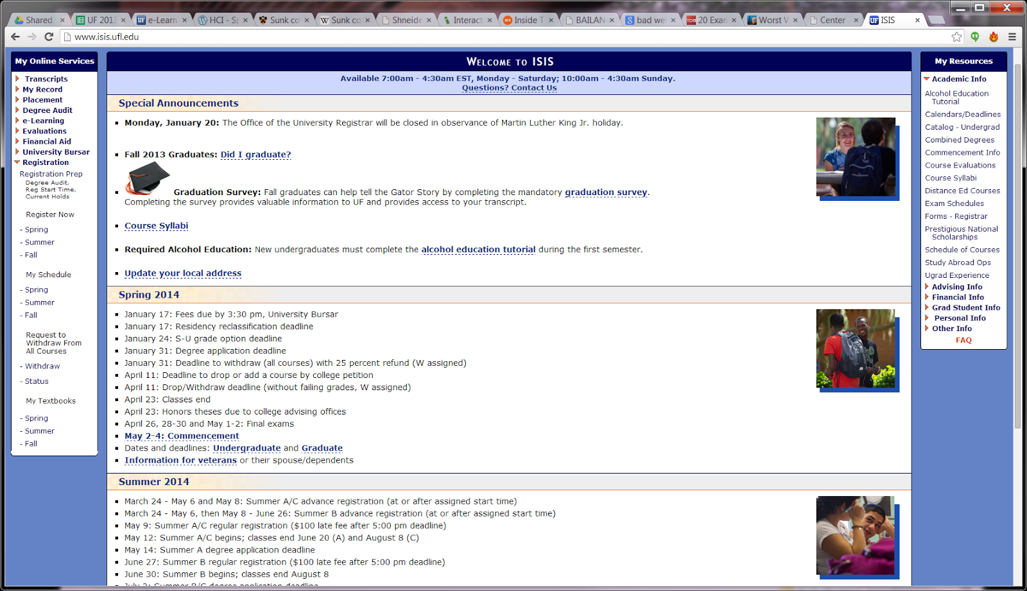
Is this any good?

Slide 3
Goal
You Should Be Able To
Explain common approaches to evaluating interfaces
Explain when to evaluate interfaces
Identify common metrics and questionnaires used in evaluating interfaces

Slide 4
Introduction
Why evaluate?
Designers become too entranced
What I like - become tied to design and lose focus of user
Experienced designers know extensive testing is required
The determinants of the evaluation plan include
stage of design (early, middle, late)
novelty of project (well defined vs. exploratory)
number of expected users
criticality of the interface (life-critical medical system vs. museum exhibit support)
costs of product and finances allocated for testing
time available
experience of the design and evaluation team

Slide 5
Introduction
How do you test…
a web site?
an air traffic control system?
How much would you budget for testing? (http://en.wikipedia.org/wiki/List_of_most_expensive_video_games_to_develop)
When do you test?
Are you required to test? (e.g. military, government, safety)

Slide 6
Dollar Auction
$1 is up for auction
You can bid any price
The $1 goes to the highest bidder
Second highest bidder pays me their bid

Slide 7
What does testing not do?
Guarantee perfection
Hard to “finish” testing
Difficult to test unusual situations
Military attack
Heavy load (e.g. voting)
Case study: Project ORCA
Simulate accurate situations
E.g. driving games, military games, medical sims

Slide 8
Project ORCA
http://arstechnica.com/information-technology/2012/11/inside-team-romneys-whale-of-an-it-meltdown/
Web app for 37,000 volunteers at polls, 800 central trackers to track voters – who still needed to vote
Training
90 minute training for 800 central volunteers
No training for field volunteers
Testing – local, not “real world”
System crash during actual load usage
Usage
Users’ first usage was 6 AM on election day
Confusion about “app” (where would you look for it)?
http vs https: no redirect to the secure site
Wrong pins and passwords
VoIP phones incorrectly configured – volunteers unable to provide support
Automated vs. Human testing
Difference in FL, OH, VA, CO was 520,000 votes

Slide 9
Expert Review
Colleagues or Customers
Informal
Natural starting point
Ask for opinions
Expert reviews
Formal
Considerations
What is an expert? User or designer?
How long? Half day to week
Different review methods from which to choose

Slide 10
Heuristic Evaluation
Experts evaluate interface on design heuristics
Shneiderman’s Eight Golden Rules
Specific to application area
Heuristics for gaming (Pinelle et al 2008)
Provide consistent responses to user’s actions (1)
Allow users to customize video and audio setting, difficulty, and game speed (2)
Provide users with information on game status (3)
…etc

Slide 11
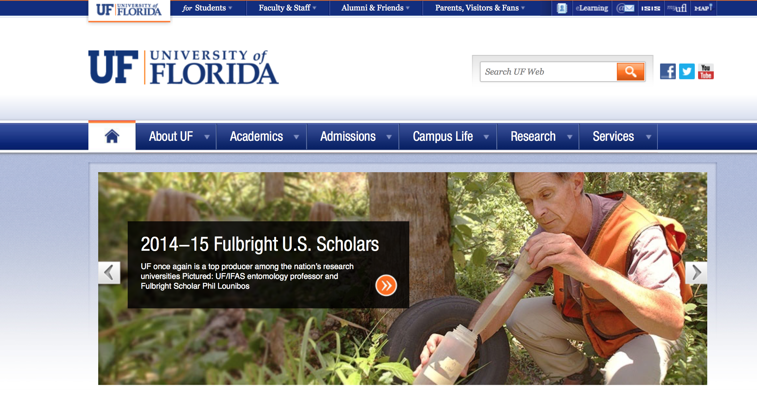
Eight Golden Rules of Interface Design
Strive for consistency
Cater to universal usability
Offer informative feedback (e.g. button clicked)
Design dialogs to yield closure (e.g. confirmation page)
Prevent errors (e.g. gray out menu items)
Permit easy reversal of actions
Support internal locus of control
Reduce short-term memory load (e.g. 7 ± 2)

Slide 12
Cognitive Walkthrough
Experts “simulate” being users going through the interface
Tasks are ordered by frequency
Good for interfaces that can be learned by “exploratory browsing” (Wharton 1994) [novices]
Usually walkthrough by themselves, then report their experiences (written, video) to designers
Useful if application is geared for a group the designers might not be familiar with:
Military, Assistive Technologies

Slide 13
Formal Usability Inspection
Experts hold courtroom-style meeting
Each side gives arguments (in an adversarial format)
Merits and weaknesses of interface
There is a judge or moderator
Good for novice designers and managers
Extensive and expensive
Requires time to prepare and more personnel than other approaches
An example of formal usability inspections in practice at Hewlett-Packard
http://www.sigchi.org/chi95/proceedings/intpost/cg_bdy.htm

Slide 14
Expert Reviews
Can be conducted at several times in the design process
Focus on comprehensiveness over specific features or random improvements
Rank recommendations by importance
HIGH: Shorten log in procedure – because users are over busy
MIDDLE: Reordering sequence of displays, removing nonessential actions, providing feedback.
Less vital fixes and novel features for future releases
Conceive
Design
Develop
Test & Refine
Alpha
Beta
Post-Release

Slide 15
Expert Review
Placed in situation similar to user
Take training courses
Read documentation
Take tutorials
Try the interface in a realistic work environment (complete with noise and distractions)
Bird’s eye view
Studying a full set of printed screens laid on the floor or pinned to the walls
Easier to evaluate topics such as consistency
Software tools to speed analyses
WebTango

Slide 16
Usability Testing and Labs
1980s, testing was luxury (but deadlines crept up)
Usability testing was incentive for deadlines
Sped up projects*
Cost savings*
Labs are different than academia
Less general theory
More practical studies

Slide 17
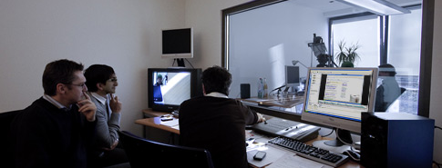
Usability Labs
IBM early leader
Microsoft next (>25 labs)
Now hundreds of companies
From http://www.ergosign.de/

Slide 18
Staff
Expertise in testing (Psych, HCI, CS)
10 to 15 projects per year
Meet with UI architect to plan testing (Figure 4.2)
Participate in early task analysis and design reviews
t – 2-6 weeks, creates study design and test plan
Task lists
Participants – number, types and sources (current customers, in company staff, temp agencies, advertisements)
t – 1 week, pilot test (procedures, tasks, and questionnaires)
1-3 participants

Slide 19
Participants
Labs categorize users based on:
Computing background
Experience with task
Motivation
Education
Ability with the language used in the interface
Controls for
Physical concerns (e.g. eyesight, handedness, age)
Experimental conditions (e.g. time of day, physical surroundings, noise, temperature, distractions)

Slide 20
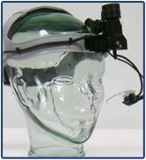
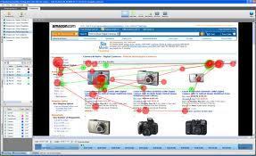
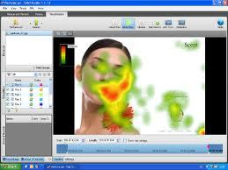
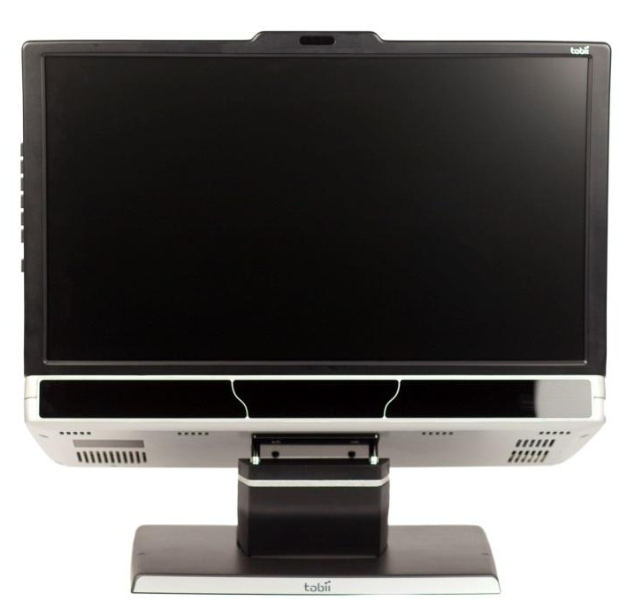
Recording Participants
Logging is important, yet tedious
Software to help (Live Logger, Morae, Spectator)
Powerful to see people use your interface
New approaches: eye tracking
Tobii (infrared to generate reflection patterns on corneas)

Slide 21
Thinking Aloud
Concurrent think aloud
Invite users to think aloud
Nothing they say is wrong
Don’t interrupt, let the user talk (sometimes need to prompt)
Spontaneous, encourages positive suggestions
Can be done in teams of participants
Retrospective think aloud
Asks people afterwards what they were thinking
Issues with accuracy (remembering)
Does not interrupt users (timings are more accurate)
https://www.youtube.com/watch?v=IHmaS0hXx4w

Slide 22
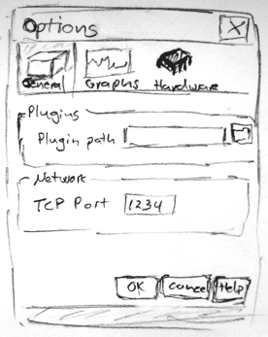
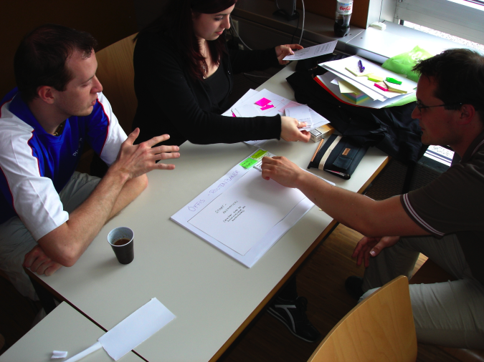
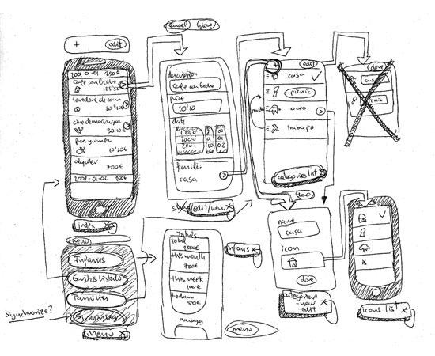
Types of Usability Testing
Paper mockups and prototyping
Inexpensive, rapid, very productive
Low fidelity is sometimes better (Synder, 2003)
https://www.youtube.com/watch?v=9wQkLthhHKA
http://images.sixrevisions.com/2010/10/28-02_iphoneapp.jpg
http://expressionflow.com/wp-content/uploads/2007/05/paper-mock-up.png
http://user.meduni-graz.at/andreas.holzinger/holzinger/papers%20en/

Slide 23
Types of Usability Testing
https://www.youtube.com/watch?v=3Qg80qTfzgU
Discount usability testing
Test early and often (with 3 to 6 testers)
Pros: Most serious problems can be found with few testers. Good for formative evaluation (early)
Cons: Complex systems can’t be tested this way. Not good for summative evaluation (late)
Competitive usability testing
Compares new interface against prior or competitor’s versions
Experimenter bias, be careful to not “prime the user”
Counterbalancing order of presentation of interfaces important
Within-subjects is preferred because can make comparisons

Slide 24
Types of Usability Testing
Universal usability testing
Test with highly diverse…
users (experience levels, ability, etc.)
platforms (mac, pc, linux)
hardware (old (how old is old?) -> latest)
networks (dial-up -> broadband)
Field tests and portable labs
Tests UI in realistic environments
Use of logging software an advantage
Beta tests – 10s or 1000s of users evaluate beta versions and asked to comment

Slide 25
Types of Usability Testing
Remote usability testing (via web)
Recruited via online communities, email
Pros: large n, adds to realism
Difficulty in logging, validating data
Software can help (NetMeeting, WebEx, Sametime)
Can You Break this Test
Challenge testers to break a system
Games, security, public displays

Slide 26
Limitations
Focuses on first-time users
Limited coverage of interface features
Testing only 1-3 hours – can’t know performance after week or month
Rarely used features
Difficult to simulate realistic conditions
Ex: Military, first response
Stress in real usage situation can lead to inability to process info (Rahman 2007)
Yet formal studies on usability testing have identified
Cost savings
Return on investment (Sherman 2006; Bias & Mayhew 2005)

Slide 27
Survey Instruments
Questionnaires
Paper or online (e.g. Qualtrics, SurveyMonkey)
Easy to grasp for many people
The power of many can be shown
80% of the 500 users who tried the system liked Option A
3 out of the 4 experts like Option B
Success depends on
Clear goals in advance
Focused items
Advantage of pilot testing – define and refine the survey questions!!

Slide 28
Designing survey questions
Ideally
Based on existing questions
Reviewed by colleagues
Pilot tested with small sample
Have built in methods to verify respondents represent population
Age
Gender
Experience
Etc…

Slide 29
Likert Scales
Most common methodology
Strongly Agree, Agree, Neutral, Disagree, Strongly Disagree
Typically 5, 7, 9-point scales
Examples
Improves my performance in book searching and buying
Enables me to search and by books faster
Makes it easier to search for an purchase books

Slide 30
Most used Likert scales
Questionnaire for User Interaction Satisfaction
System Usability Scale (SUS) – Brooke 1996
10 questions: 5 pos worded, 5 neg worded (reverse coding)
Post-Study System Usability Questionniare
Computer System Usability Questionniare
Software usability Measurement Inventory
Website Analysis and MeasureMent Inventory
Mobile Phone Usability Questionnaire
Questionnaire websites
Gary Perlman’s website, Jurek Kirakowski’s website

Slide 31
Acceptance Tests
Set goals for performance
Objective
Measurable
Requirements document
We want the software to be “user friendly”
Vague and misleading criterion
How could we rephrase it?
Use a metric such as Shneiderman’s goals for interface design
Time for users to learn specific functions
Speed of Task performance
Rate of Errors
User retention of commands over time
Subjective satisfaction

Slide 32
Examples: food shopping website
Test A
The participants will be
35 adults (25-45 years old)
Native speakers with no disabilities
Hired from an employment agency
Moderate web-use experience (1-5 hours/week) for at least one year
≥30 of the 35 should complete the benchmark tests within 30 minutes
Test B
10 participants will be recalled after one week
Carry out new set of benchmark tests
In 20 minutes, at least 8 should be able to complete tasks correctly
Notes:
(page 173 in book)

Slide 33
Acceptance Tests
Completing the acceptance tests
Can be part of contractual fulfillment
Demonstrate objectivity
Different than usability tests
More adversarial
Neutral party should conduct that
Central goal
To verify requirements adhered to
Not to detect flaws

Slide 34
Evaluation during active use
Interviews with individual users
Pro: Get very detailed on specific concerns
Cons: Costly and time-consuming
Focus group discussions
Pro: identify patterns of usage or hidden problems
Con: Certain people can dominate or sway opinion
Targeted interviews and focus groups
Experienced or long-term users
Identify different issues than novice users

Slide 35
Evaluation during active use
Continuous logging
The system itself logs user usage
Video game example
Other examples
Track frequency of errors** (gives an ordered list of what to address via tutorials, training, text changes, etc.)
Speed of performance
Track which features are used and which are not
Web Analytics
Ethical considerations
Privacy? What gets logged? Opt-in/out?
What about companies?

Slide 36
Online and Telephone Help
Users feel reassured having people ready to help (real-time chat online or via telephone)
E.g. (2008) Netflix has 8.4 million customers, how many telephone customer service reps?
375
Expensive, but higher customer satisfaction
Cheaper versions are bug report systems
Windows, Chrome, Bugzilla

