Slide 1
ELLIPTIC CURVE CRYPTOGRAPHY
By
Abhijith Chandrashekar
and
Dushyant Maheshwary

Slide 2
Introduction
What are Elliptic Curves?
Curve with standard form y² = x³ + ax + b a, b ϵ ℝ
Characteristics of Elliptic Curve
Forms an abelian group
Symmetric about the x-axis
Point at Infinity acting as the identity element

Slide 3
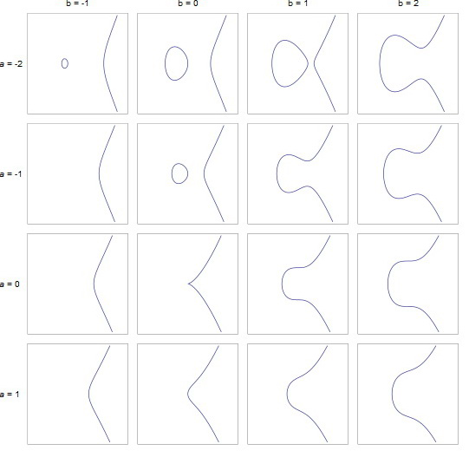
Examples of Elliptic Curves

Slide 4
Finite Fields
aka Galois Field
GF(p^{n}) = a set of integers {0, 1, 2, …, p^{n} -1)
where p is a prime, n is a positive integer
It is denoted by {F, +, x}
where + and x are the group operators

Slide 5
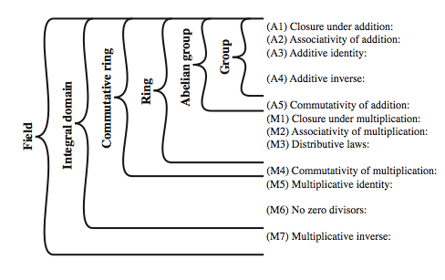
Group, Ring, Field

Slide 6
Why Elliptic Curve Cryptography?
Shorter Key Length
Lesser Computational Complexity
Low Power Requirement
More Secure

Slide 7
Comparable Key Sizes for Equivalent Security
Symmetric Encryption (Key Size in bits) | RSA and Diffie-Hellman (modulus size in bits) | ECC Key Size in bits
56 | 512 | 112
80 | 1024 | 160
112 | 2048 | 224
128 | 3072 | 256
192 | 7680 | 384
256 | 15360 | 512

Slide 8
What is Elliptic Curve Cryptography?
Implementing Group Operations
Main operations - point addition and point multiplication
Adding two points that lie on an Elliptic Curve – results in a third point on the curve
Point multiplication is repeated addition
If P is a known point on the curve (aka Base point; part of domain parameters) and it is multiplied by a scalar k, Q=kP is the operation of adding P + P + P + P… +P (k times)
Q is the resulting public key and k is the private key in the public-private key pair

Slide 9
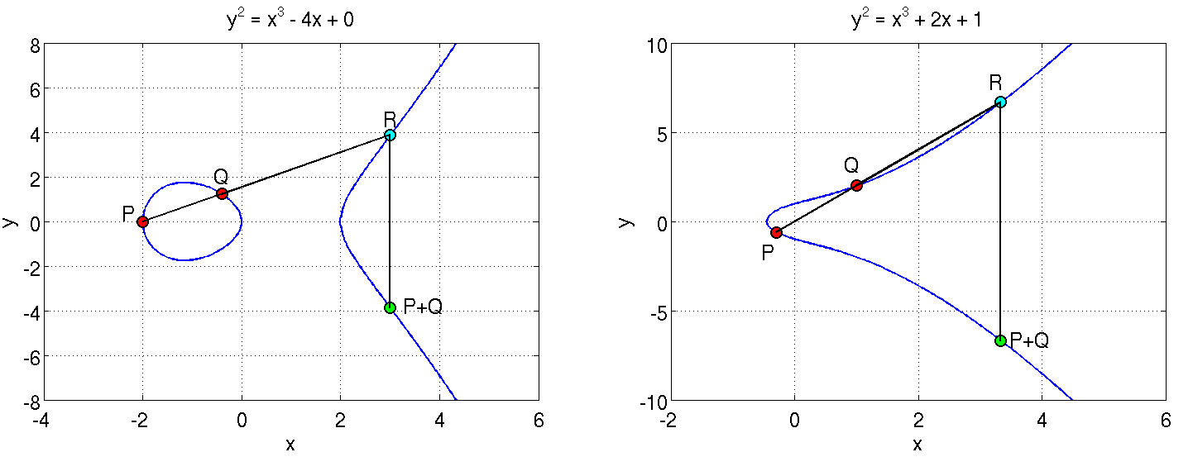
What is Elliptic Curve Cryptography?
Adding two points on the curve
P and Q are added to obtain P+Q which is a reflection of R along the X axis

Slide 10
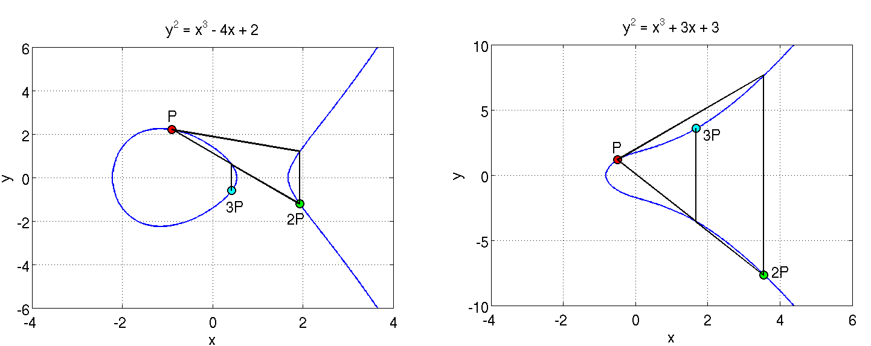
What is Elliptic Curve Cryptography?
A tangent at P is extended to cut the curve at a point; its reflection is 2P
Adding P and 2P gives 3P
Similarly, such operations can be performed as many times as desired to obtain Q = kP

Slide 11
What is Elliptic Curve Cryptography?
Discrete Log Problem
The security of ECC is due the intractability or difficulty of solving the inverse operation of finding k given Q and P
This is termed as the discrete log problem
Methods to solve include brute force and Pollard’s Rho attack both of which are computationally expensive or unfeasible
The version applicable in ECC is called the Elliptic Curve Discrete Log Problem
Exponential running time

Slide 12
ECC in Windows DRM v2.0
A Practical Example :
Finite field chosen
p = 785963102379428822376694789446897396207498568951
Gx = 771507216262649826170648268565579889907769254176
Gy = 390157510246556628525279459266514995562533196655
y² = x³ + 317689081251325503476317476413827693272746955927x + 790528966078787587181205720257185354321100651934
Gx and Gy constitute the agreed upon base point (P) and the numbers in the above equation are values for the parameters a and b

Slide 13
Elliptic Curve Schemes
Elliptic Curve Digital Signature Algorithm (ECDSA)
Elliptic Curve Pintsov Vanstone Signature(ECPVS)
Elliptic Curve Diffie-Hellman (ECDH)

Slide 14
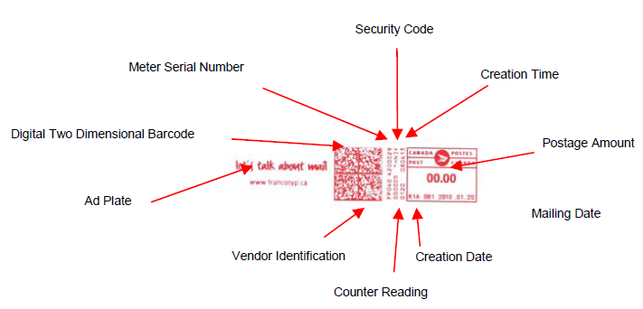
Elliptic Curve Digital Signature Algorithm (ECDSA)
Elliptic curve variant of Digital Signature Algorithm
Canadian postage stamp that uses ECDSA

Slide 15
ECDSA
Signature Generation
Once we have the domain parameters and have decided on the keys to be used, the signature is generated by the following steps.
1. A random number k, 1 ≤ k ≤ n-1 is chosen
2. kG = (x₁,y₁) is computed. x₁ is converted to its corresponding integer x₁’
3. Next, r = x₁ mod n is computed
4. We then compute k⁻¹ mod q
5. e = HASH(m) where m is the message to be signed
6. s = k⁻¹(e + dr) mod n
where d is the private key of the sender.
We have the signature as (r,s)

Slide 16
ECDSA
Signature Verification
At the receiver’s end the signature is verified as follows:
1. Verify whether r and s belong to the interval [1, n-1] for the signature to be valid.
2. Compute e = HASH(m). The hash function should be the same as the one used for signature generation.
3. Compute w = s⁻¹ mod n.
4. Compute u₁ = ew mod n and u₂ = rw mod n.
5. Compute (x₁,y₁) = u₁G + u₂Q.
6. The signature is valid if r = x₁ mod n, invalid otherwise.
This is how we know that the verification works the way we want it to:
We have, s = k⁻¹(e + dr) mod n which we can rearrange to obtain, k = s⁻¹(e + dr) which is
s⁻¹e + s⁻¹rd
This is nothing but we + wrd = (u₁ + u₂d) (mod n)
We have u₁G + u₂Q = (u₁ + u₂d)G = kG which translates to v = r.

Slide 17
Elliptic Curve Pintsov Vanstone Signature (ECPVS)
Signature scheme using Elliptic Curves
More efficient than RSA as overhead is extremely low

Slide 18
ECPVS
Signature Generation
The plaintext message is split into two parts: part C representing the data elements requiring confidentiality and part V representing the data elements presented in plaintext. Both the parts are signed. The signature is generated as follows:
1. A random number k, 1 ≤ k ≤ n-1 is chosen.
2. Calculate the point R on the curve (R = kG).
3. Use point R and a symmetric encryption algorithm to get e = T_{R}(C).
4. Calculate a variable d such that d = HASH(e || I_{A} || V)
where I_{A} is the identity of the mailer terminal.
5. Now calculate the other part of the signature s as follows: s= ad + k(mod n); where a is the private key of the sender.
The signature pair (s,e) is transmitted together with the portion V of the plaintext.

Slide 19
ECPVS
Signature Verification
Retrieve Q_{A} (Q_{A} is mailer A’s public key)
Calculate the variable d = HASH(e || I_{A} || V) using the same HASH algorithm as the one used for generating the signature.
Compute U = sG – dQ_{A}.
Recover C = T_{u}⁻¹(e).
Run a redundancy test on C. If the test fails, discard the message. Else, the plaintext is recovered.
We have, s = ad + k. Multiply by base point G to obtain sG = adG + kG which is dQ_{A} + R
Therefore, R = sG – dQ_{A} which is U. Comparing the decrypted versions, m and m’ obtained using U and R, we ascertain the validity of the signature

Slide 20
Elliptic Curve Diffie-Hellman (ECDH)
Elliptic curve variant of the key exchange Diffie-Hellman protocol.
Decide on domain parameters and come up with a Public/Private key pair
To obtain the private key, the attacker needs to solve the discrete log problem

Slide 21
ECDH
How the key exchange takes place:
1. Alice and Bob publicly agree on an elliptic curve E over a large finite field F and a point P on that curve.
2. Alice and Bob each privately choose large random integers, denoted a and b
3. Using elliptic curve point-addition, Alice computes aP on E and sends it to Bob. Bob computes bP on E and sends it to Alice.
4. Both Alice and Bob can now compute the point abP Alice by multiplying the received value of bP by her secret number a and Bob vice-versa.
5. Alice and Bob agree that the x coordinate of this point will be their shared secret value.

Slide 22
Pros and Cons
Pros
Shorter Key Length
Same level of security as RSA achieved at a much shorter key length
Better Security
Secure because of the ECDLP
Higher security per key-bit than RSA
Higher Performance
Shorter key-length ensures lesser power requirement – suitable in wireless sensor applications and low power devices
More computation per bit but overall lesser computational expense or complexity due to lesser number of key bits

Slide 23
Pros and Cons
Cons
Relatively newer field
Idea prevails that all the aspects of the topic may not have been explored yet – possibly unknown vulnerabilities
Doesn’t have widespread usage
Not perfect
Attacks still exist that can solve ECC (112 bit key length has been publicly broken)
Well known attacks are the Pollard’s Rho attack (complexity O(√n) ), Pohlig’s attack, Baby Step,Giant Step etc

